Slide 1
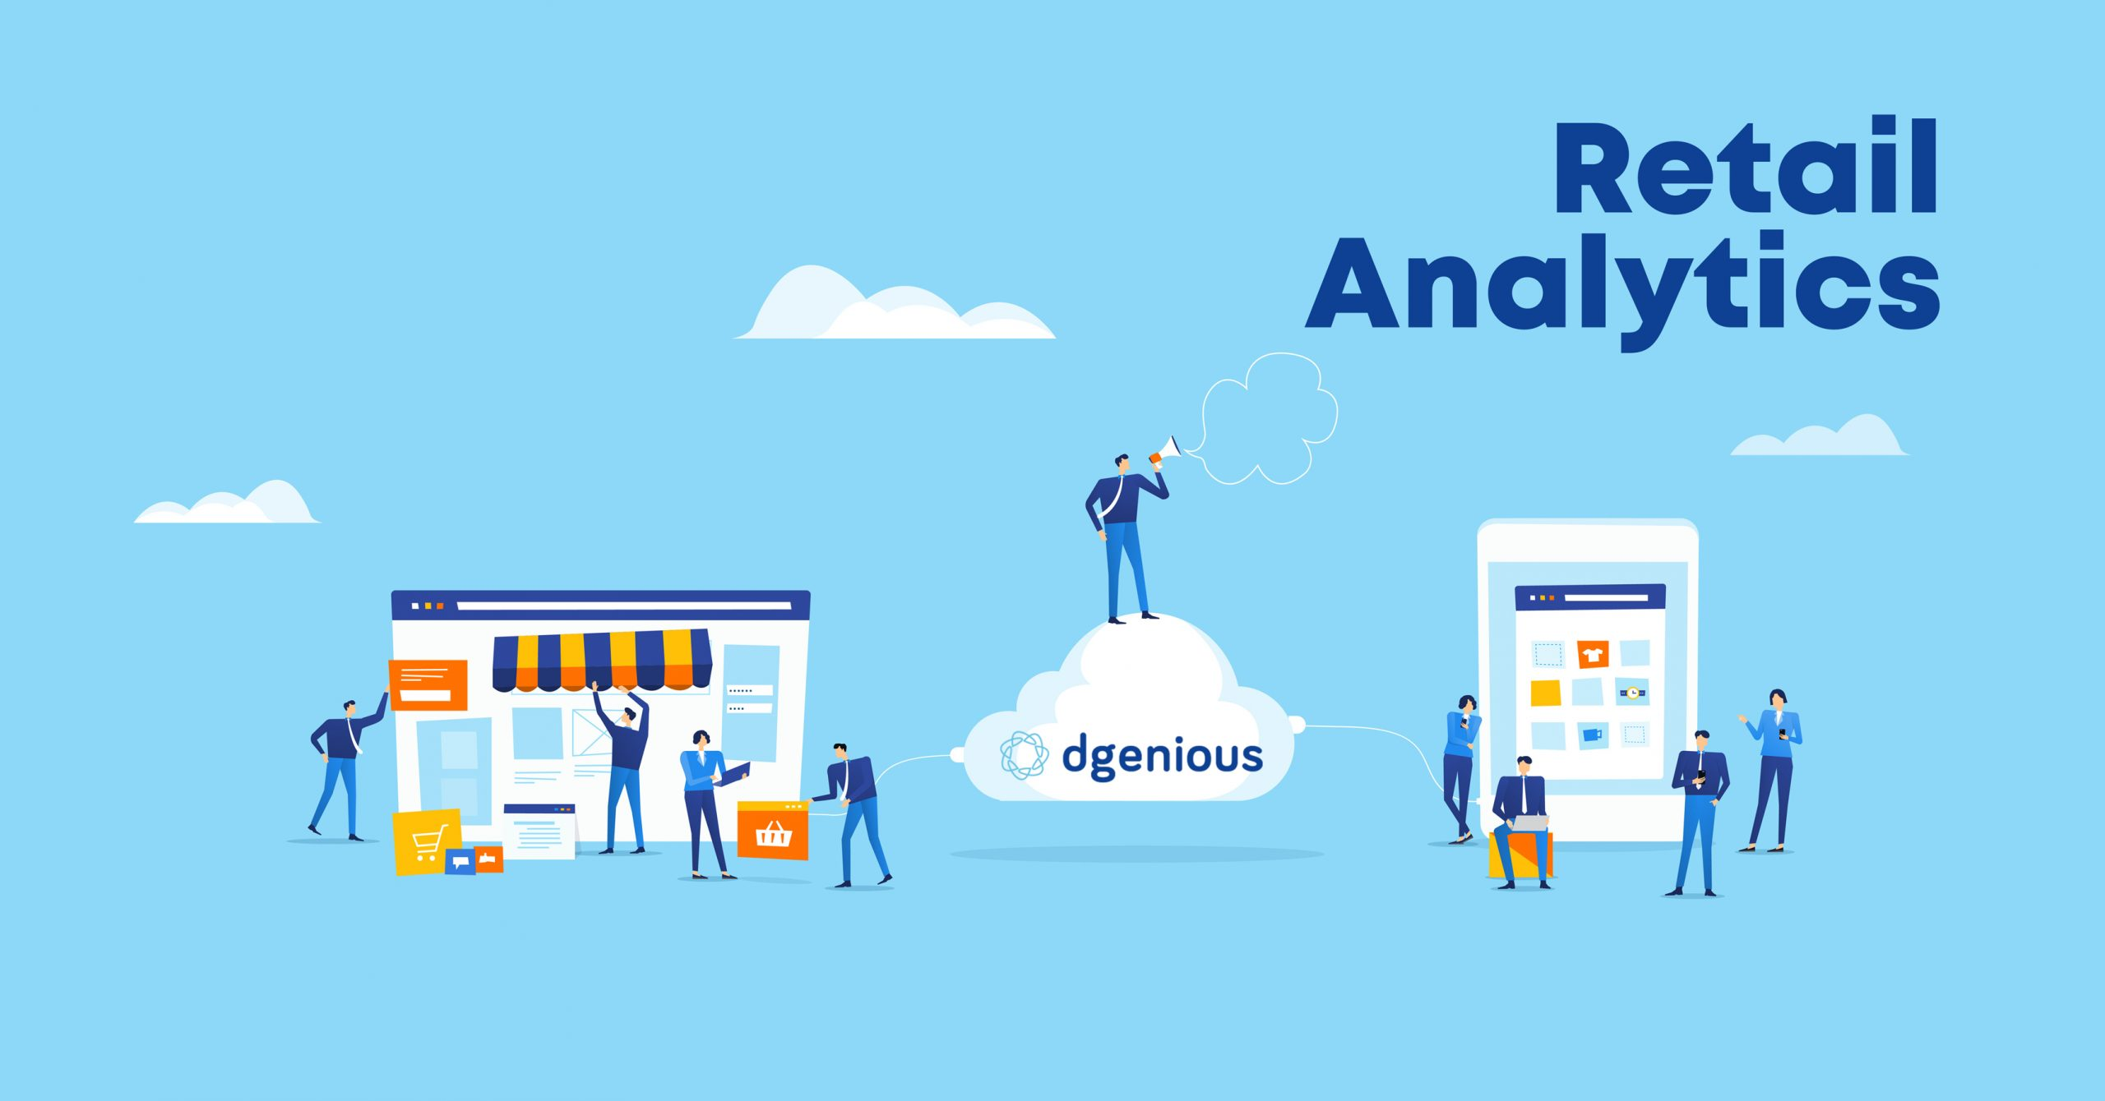

Capstone Project
Retail Analytics
Notes:
Hello my name is Harshad Daulat Sawkar ,
I am working on Retail Analytics Capstone Project Given By Acciojob,

Slide 2

Overview
The objective of this project is to develop a Power BI dashboard using the Retail Database to provide comprehensive insights into the retail business's performance. The dashboard will focus on sales, product, customer, and demographic analysis, aiming to facilitate data-driven decision-making, optimize sales strategies, and enhance customer experiences
The goal is to empower retail stakeholders with actionable insights, enabling them to identify top-selling products
Notes:
The objective of this project is to develop a Power BI dashboard using the Retail Database to provide comprehensive insights into the retail business's performance. The dashboard will focus on sales, product, customer, and demographic analysis, aiming to facilitate data-driven decision-making, optimize sales strategies, and enhance customer experiences. The goal is to empower retail stakeholders with actionable insights, enabling them to identify top-selling products, customer preferences, and target demographics. The dashboard will offer valuable insights and recommendations for targeted marketing, inventory optimization, and personalized customer experiences. The final deliverables will include a report and presentation showcasing the dashboard's findings and significance, serving as a powerful tool for retail stakeholders to improve business strategies and achieve success in the competitive retail market.

Slide 3

Problem Statement
Objective
Analysis Scope
Goal
Insights & Recommendations.
Report & Presentation
Notes:
"Effective retail analytics is needed to tackle challenges in optimizing product assortment, pricing strategies, inventory management, and customer engagement. There is a growing demand for data-driven insights to enhance decision-making in an increasingly competitive retail landscape, where understanding consumer behavior and market trends is crucial for sustainable growth and profitability."

Slide 4
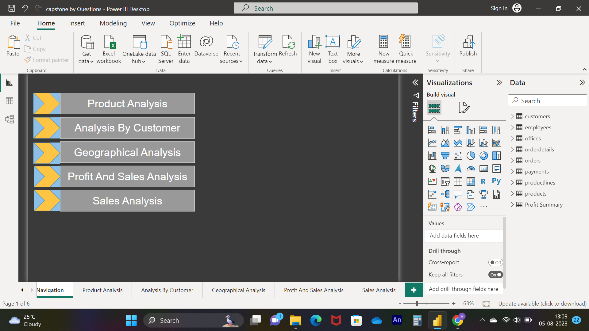

We are going to deep dive analyse of this top
Notes:
1) Product Analysis: Evaluating product features, quality, and pricing to enhance competitiveness and guide development.
2) Analysis By Customer: Understanding customer preferences through segmentation for tailored marketing and improved satisfaction.
3) Geographical Analysis: Examining sales and trends across regions to optimize distribution and target markets effectively.
4) Profit And Sales Analysis: Assessing revenue, costs, and profitability to refine pricing, sales strategies, and maximize margins.
5) Sales Analysis: Analyzing sales data by product, region, and time for insights into trends, seasonality, and inventory management.

Slide 5
Product Analysis
Customer Analysis
Profit And Sale Analysis
Sales Analysis
Conclusion
Geographical Analysis
Notes:
1) Product Analysis: Checking our products to make sure they're good, priced right, and better than others.
2) Analysis By Customer: Figuring out what our customers like so we can make them happy and offer what they want.
3) Geographical Analysis: Looking at where we sell stuff to decide where to focus more and how to deliver better.
4) Profit And Sales Analysis: Seeing how much money we're making from selling things, and how we can make even more money by selling smarter.
5) Sales Analysis: Studying what we sell, where we sell it, and when we sell it to plan better and keep the right stuff in stock.

Slide 6
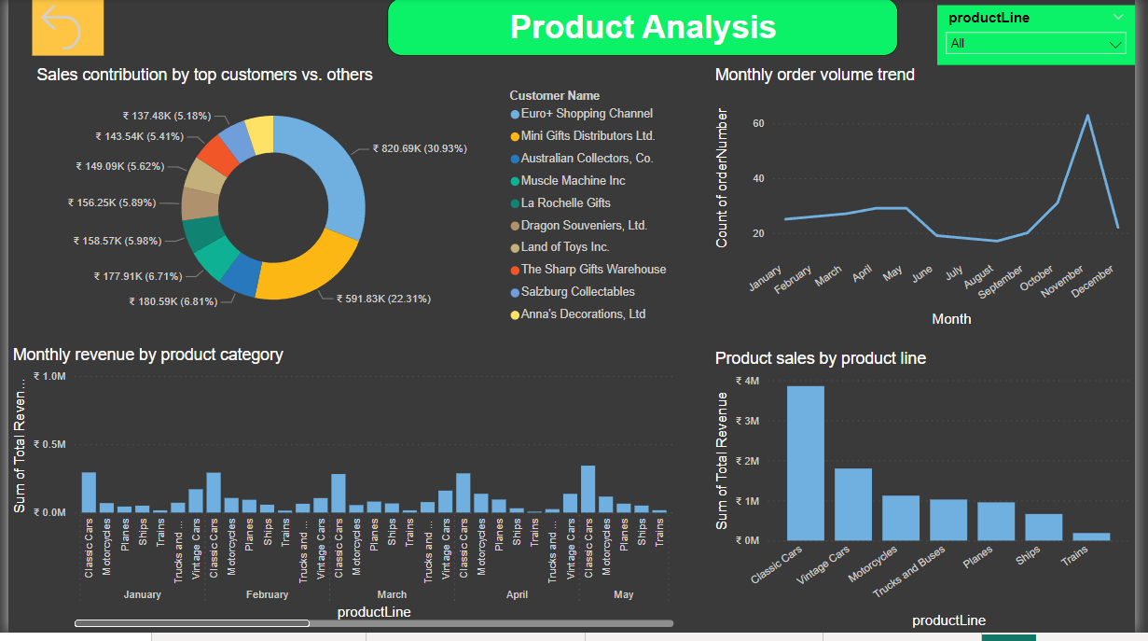
Notes:
Product analysis involves a comprehensive assessment of the various aspects of your products. This includes evaluating their features, benefits, quality, pricing, and how they compare to competitors' offerings. By analyzing your products, you can identify strengths and weaknesses, determine areas for improvement, and make informed decisions about product development and marketing strategies.
As we can see in Above Slide we need to Focus on Ships And Trains Revenue because as compare to others it is going down.
Also we are getting good volume of orders at the last quarter so we need to introduce some other product as well in last quarter.
INSIGHT 1) need to focused on getting more sale Volumes in 1,2 as well as 3 Quarter
2) need to Focus on Ships And Trains Revenue because as compare to others it is going down
or we need to replace our this product with others as per trend or related one with the same field

Slide 7
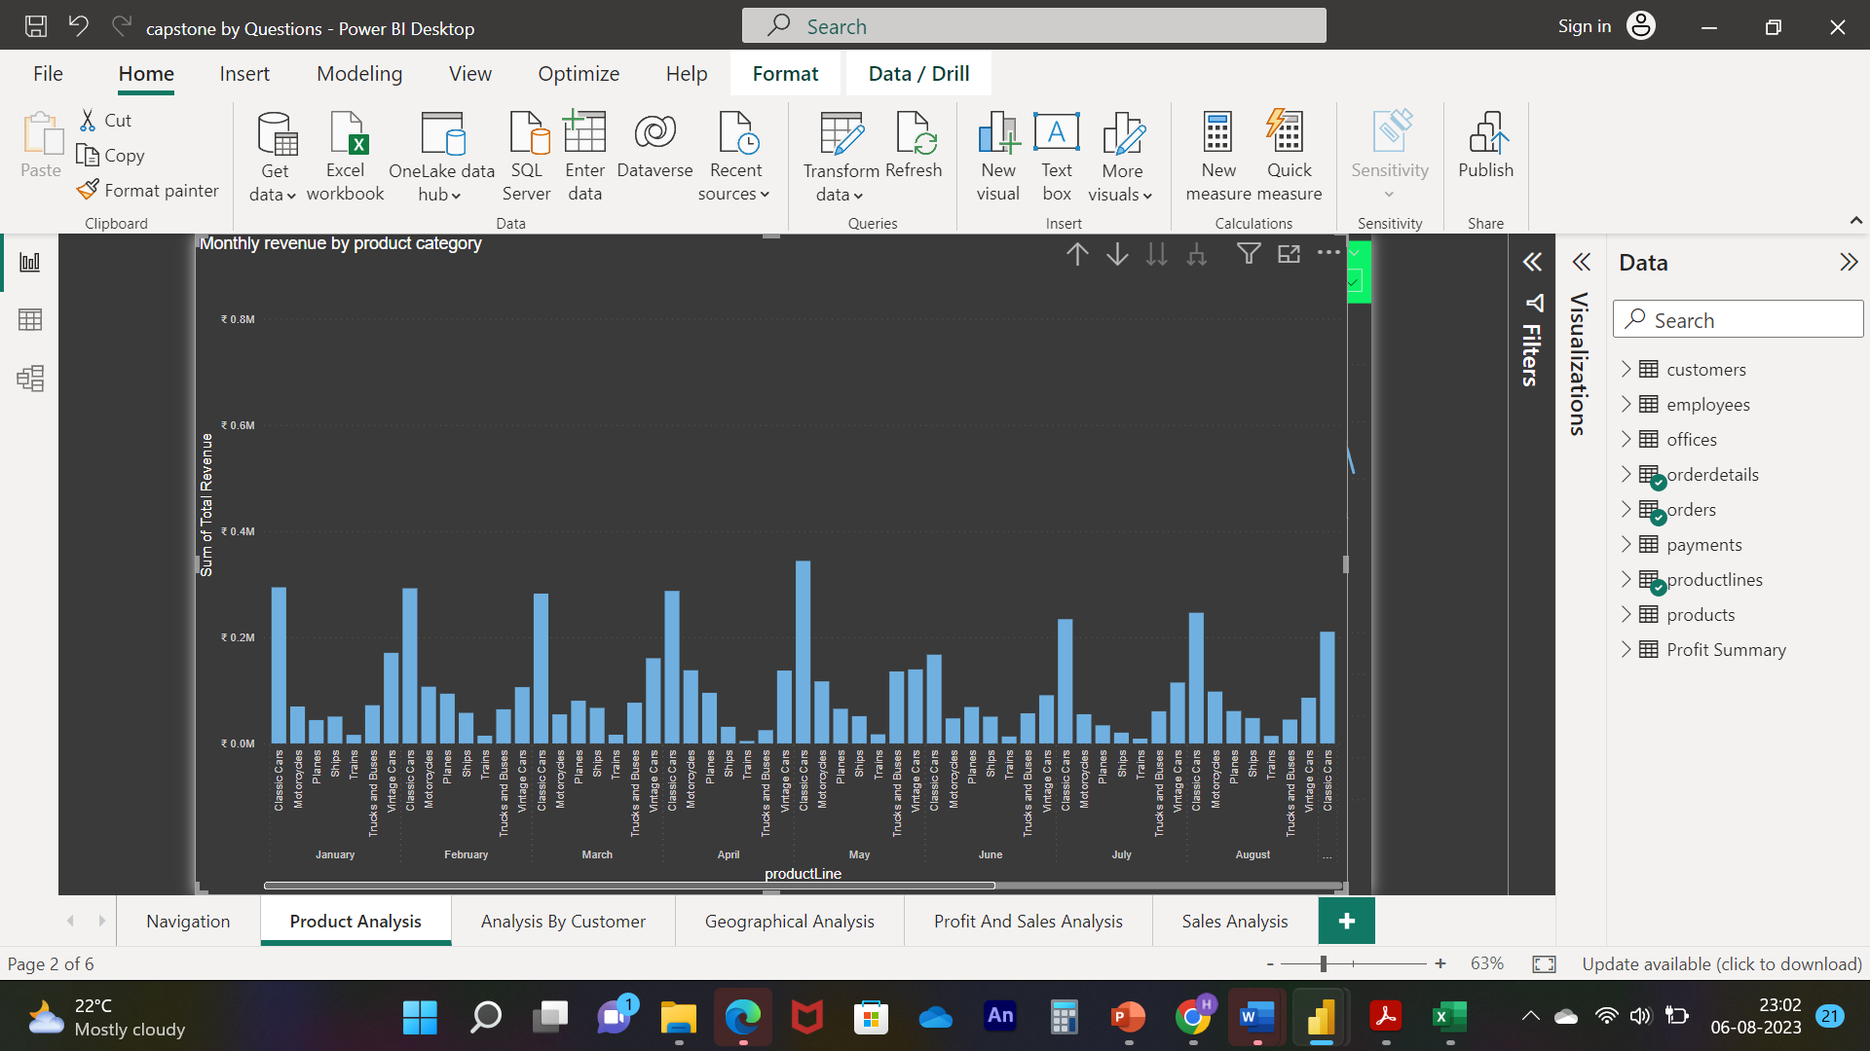
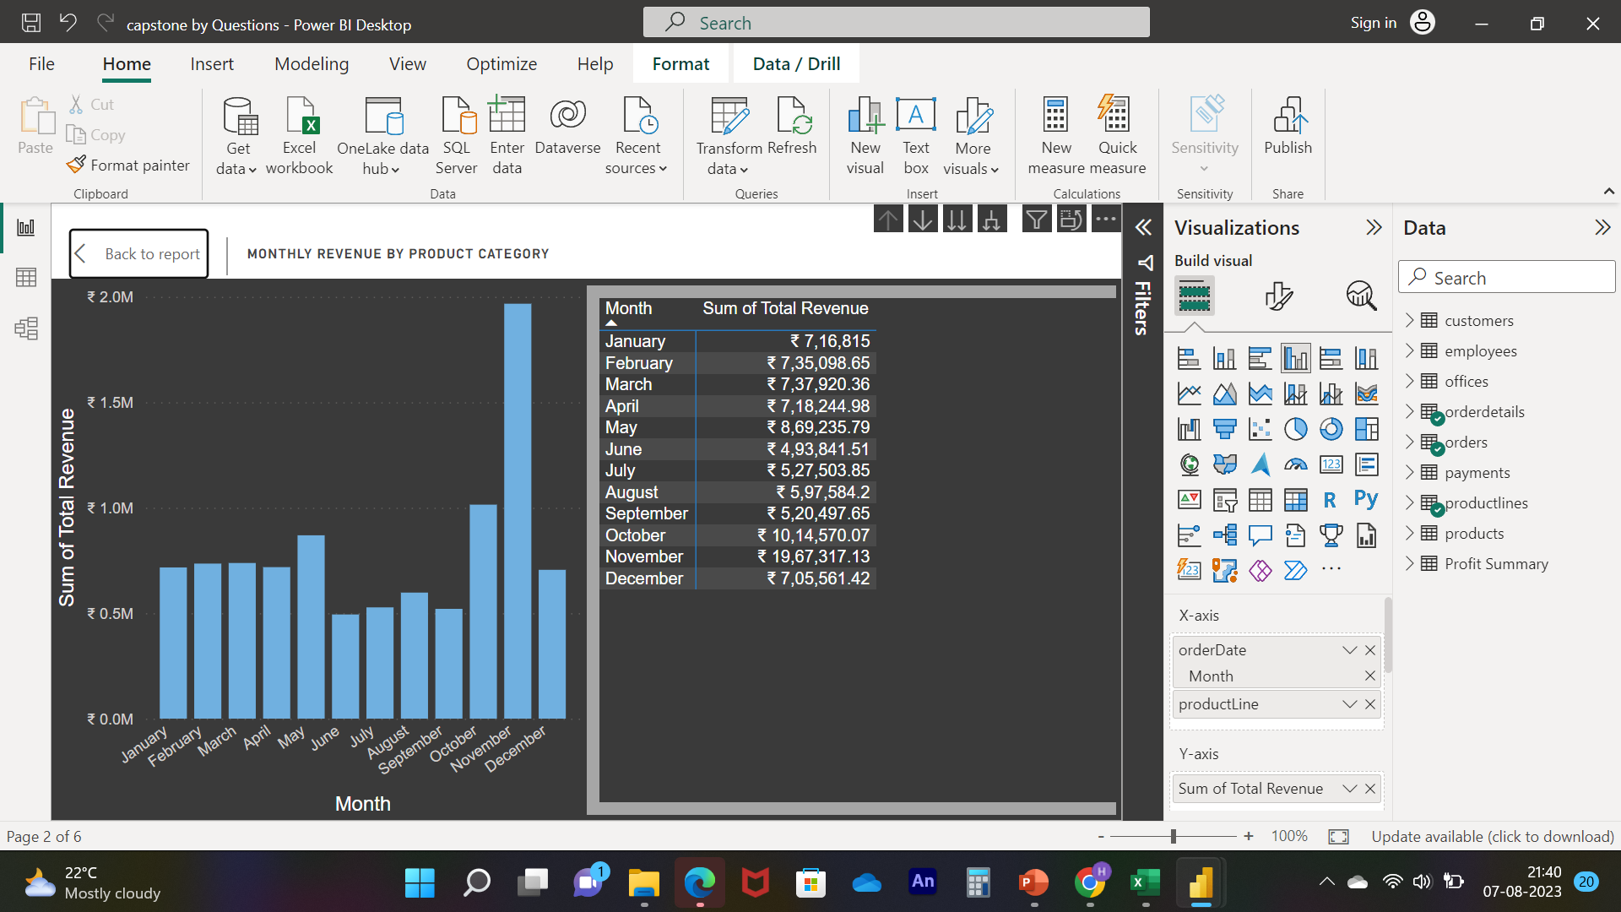
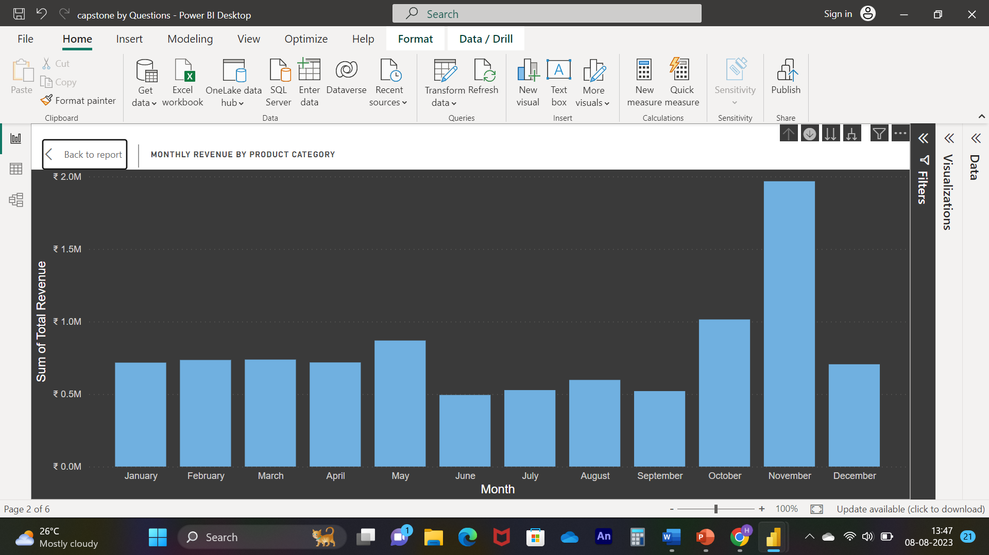
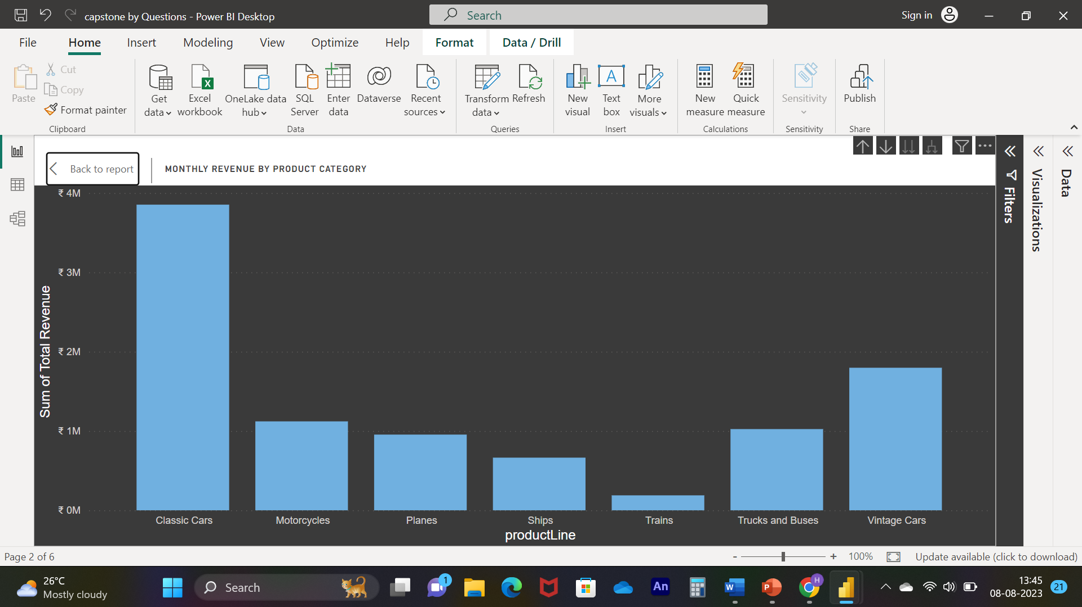
Notes:
Q. NO. 01 :- How does monthly revenue vary across different product categories?
Solution :- As we can see in the visuals the CLASSIC CAR has more revenue in every
months as compare to other category, in fact in the MAY it was highest
revenue making category
﻿November in product Line made up 8.54% of Total Revenue.﻿
﻿At ₹ 38,53,922.49, Classic Cars had the highest Sum of Total Revenue and was 1,944.16% higher than Trains, which had the lowest Sum of Total
Revenue at ₹ 1,88,532.92.﻿﻿ ﻿﻿ ﻿ ﻿﻿ ﻿﻿Classic Cars accounted for 40.13% of Sum of Total Revenue.﻿﻿ ﻿﻿ ﻿﻿Across all 7 product Line, Sum of Total Revenue ranged from
₹ 1,88,532.92 to ₹ 38,53,922.49.﻿﻿ ﻿﻿ ﻿
﻿At ₹ 19,67,317.13, November had the highest Sum of Total Revenue and was 298.37% higher than June, which had the lowest Sum of Total Revenue at
₹ 4,93,841.51.﻿﻿ ﻿﻿ ﻿﻿[]﻿﻿ ﻿﻿ ﻿﻿November accounted for 20.48% of Sum of Total Revenue.﻿﻿ ﻿﻿ ﻿﻿Across all 12 Month, Sum of Total Revenue ranged from ₹ 4,93,841.51 to
₹ 19,67,317.13.﻿﻿ ﻿﻿ ﻿

Slide 8
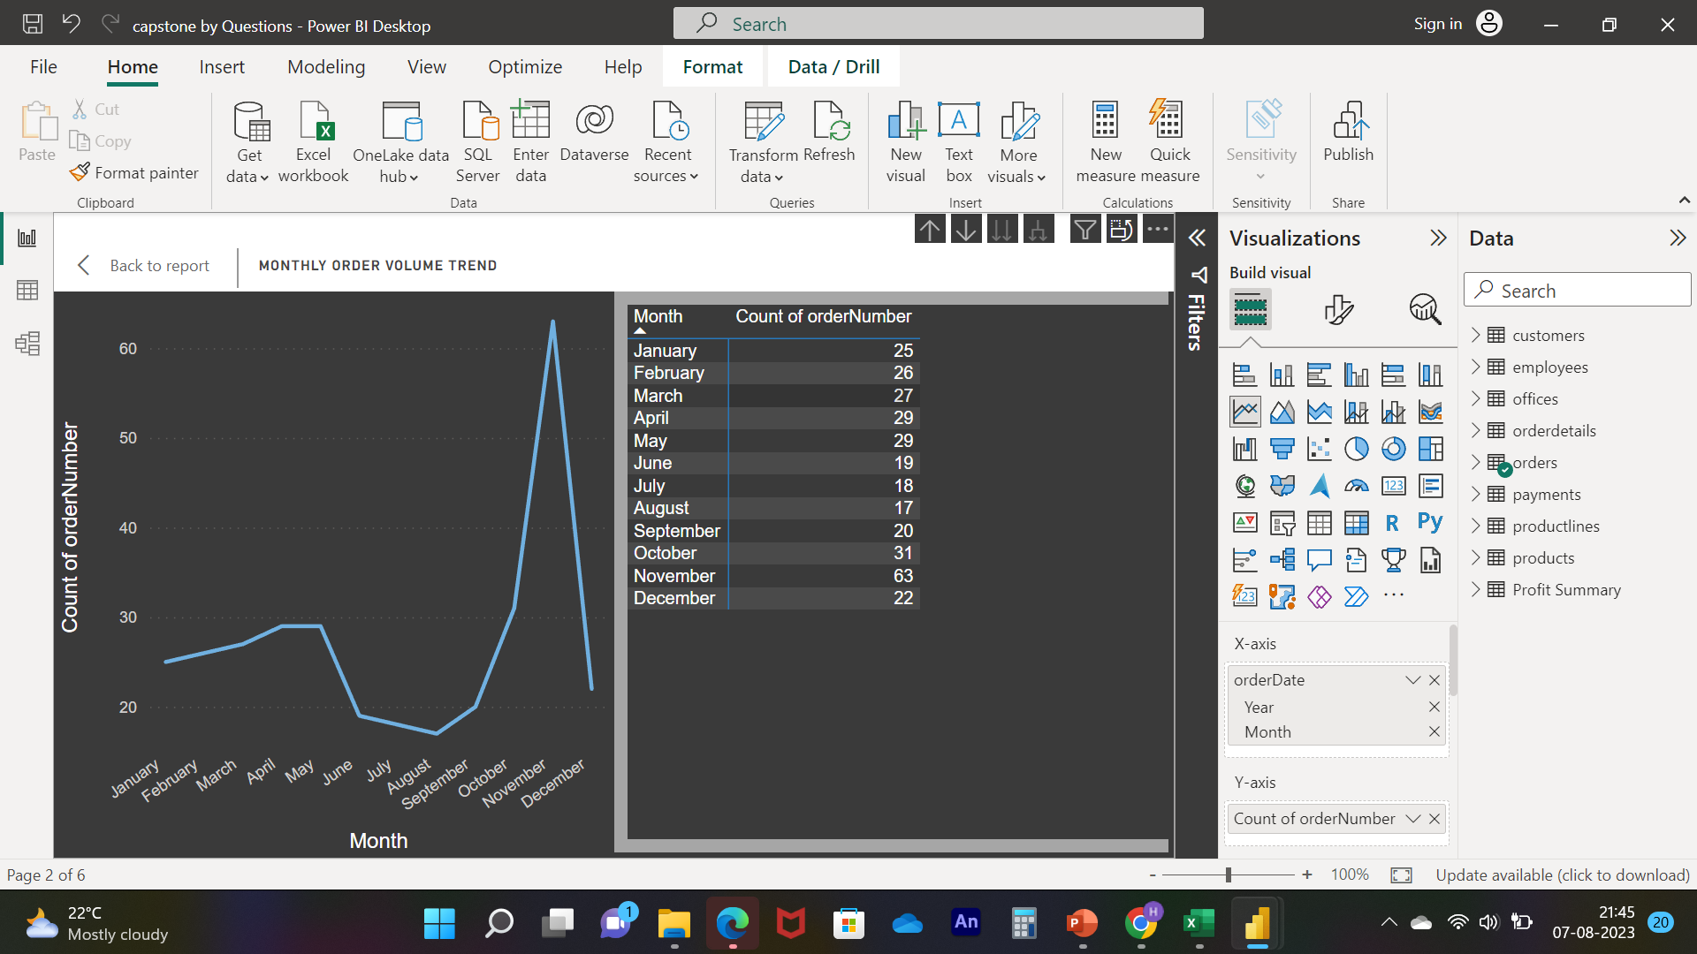
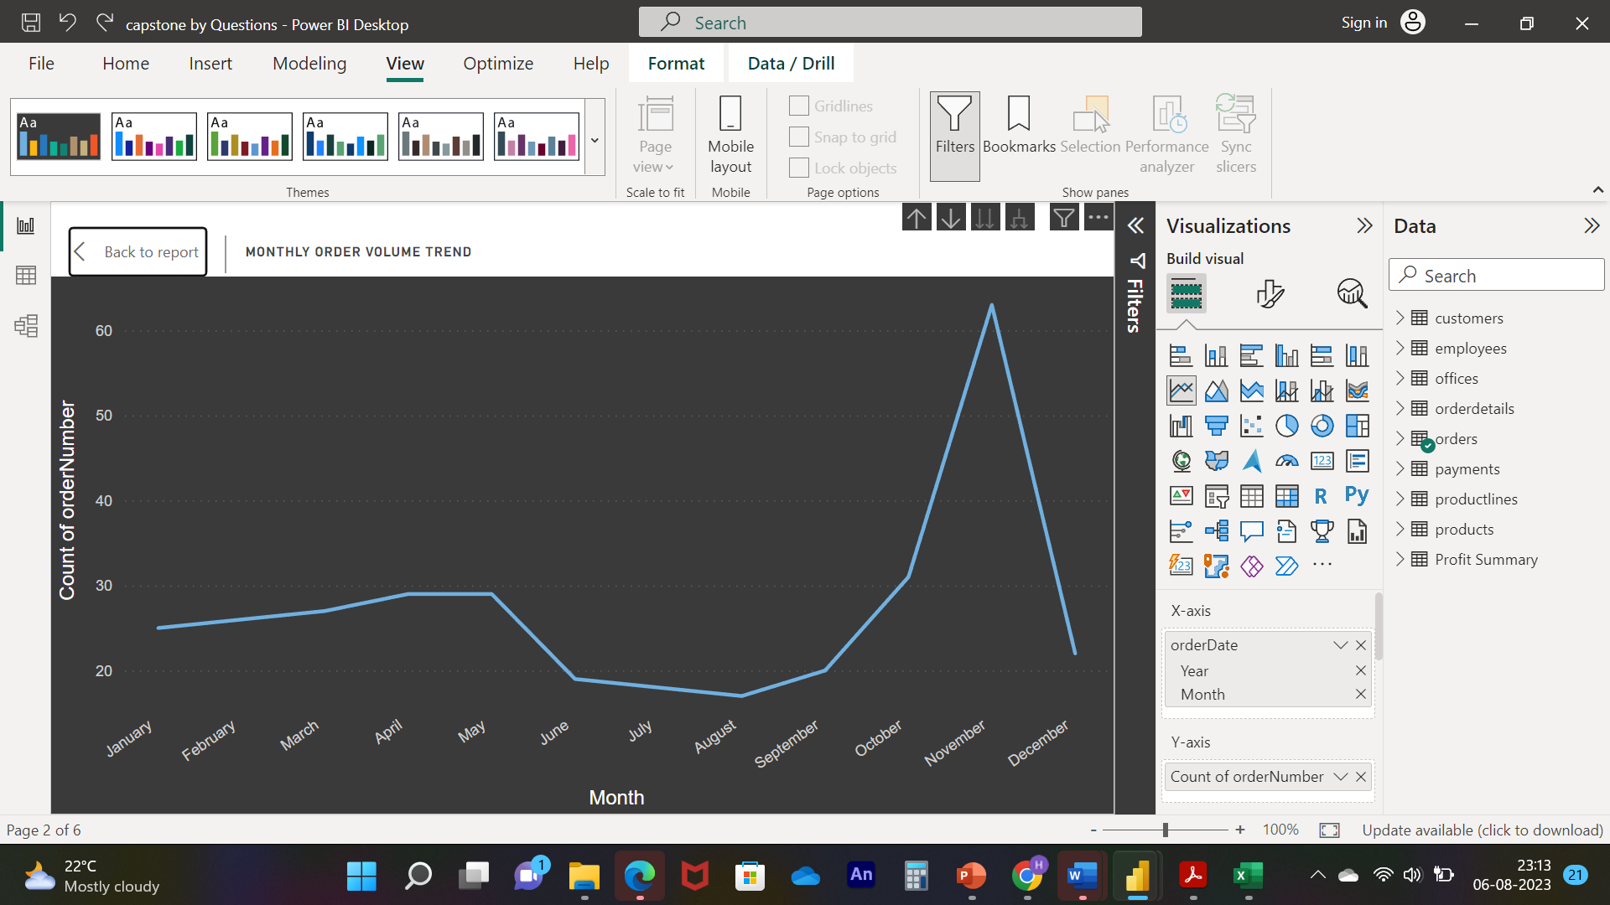
Notes:
Q. NO. 02 :- What is the trend in customer order volume over the past year? (Visual: Monthly order volume trend)
Solution :- As we can see in visuals in the first and second Quarter order trend was uniform in between 20 to 30
but in the 3rd quarter we can see suddenly drops of order trend which was below the 20 , and in 4th
we can see suddenly spikes which was above 60 , that was highest orders in the year , so we need to analyse
what kind of implementation we were made in the last quarter , and in the next coming year we need to follow
the same approaches to gain more orders.
﻿Count of orders trended down, resulting in a 12.00% decrease between January 2003 and December 2003.﻿﻿ ﻿﻿ ﻿﻿Count of orders started trending up on July 2003, rising by 22.22% (4) in 5 months.﻿﻿ ﻿﻿ ﻿﻿Count of orders jumped from 18 to 22 during its steepest incline between July 2003 and December 2003.﻿﻿ ﻿﻿ ﻿

Slide 9
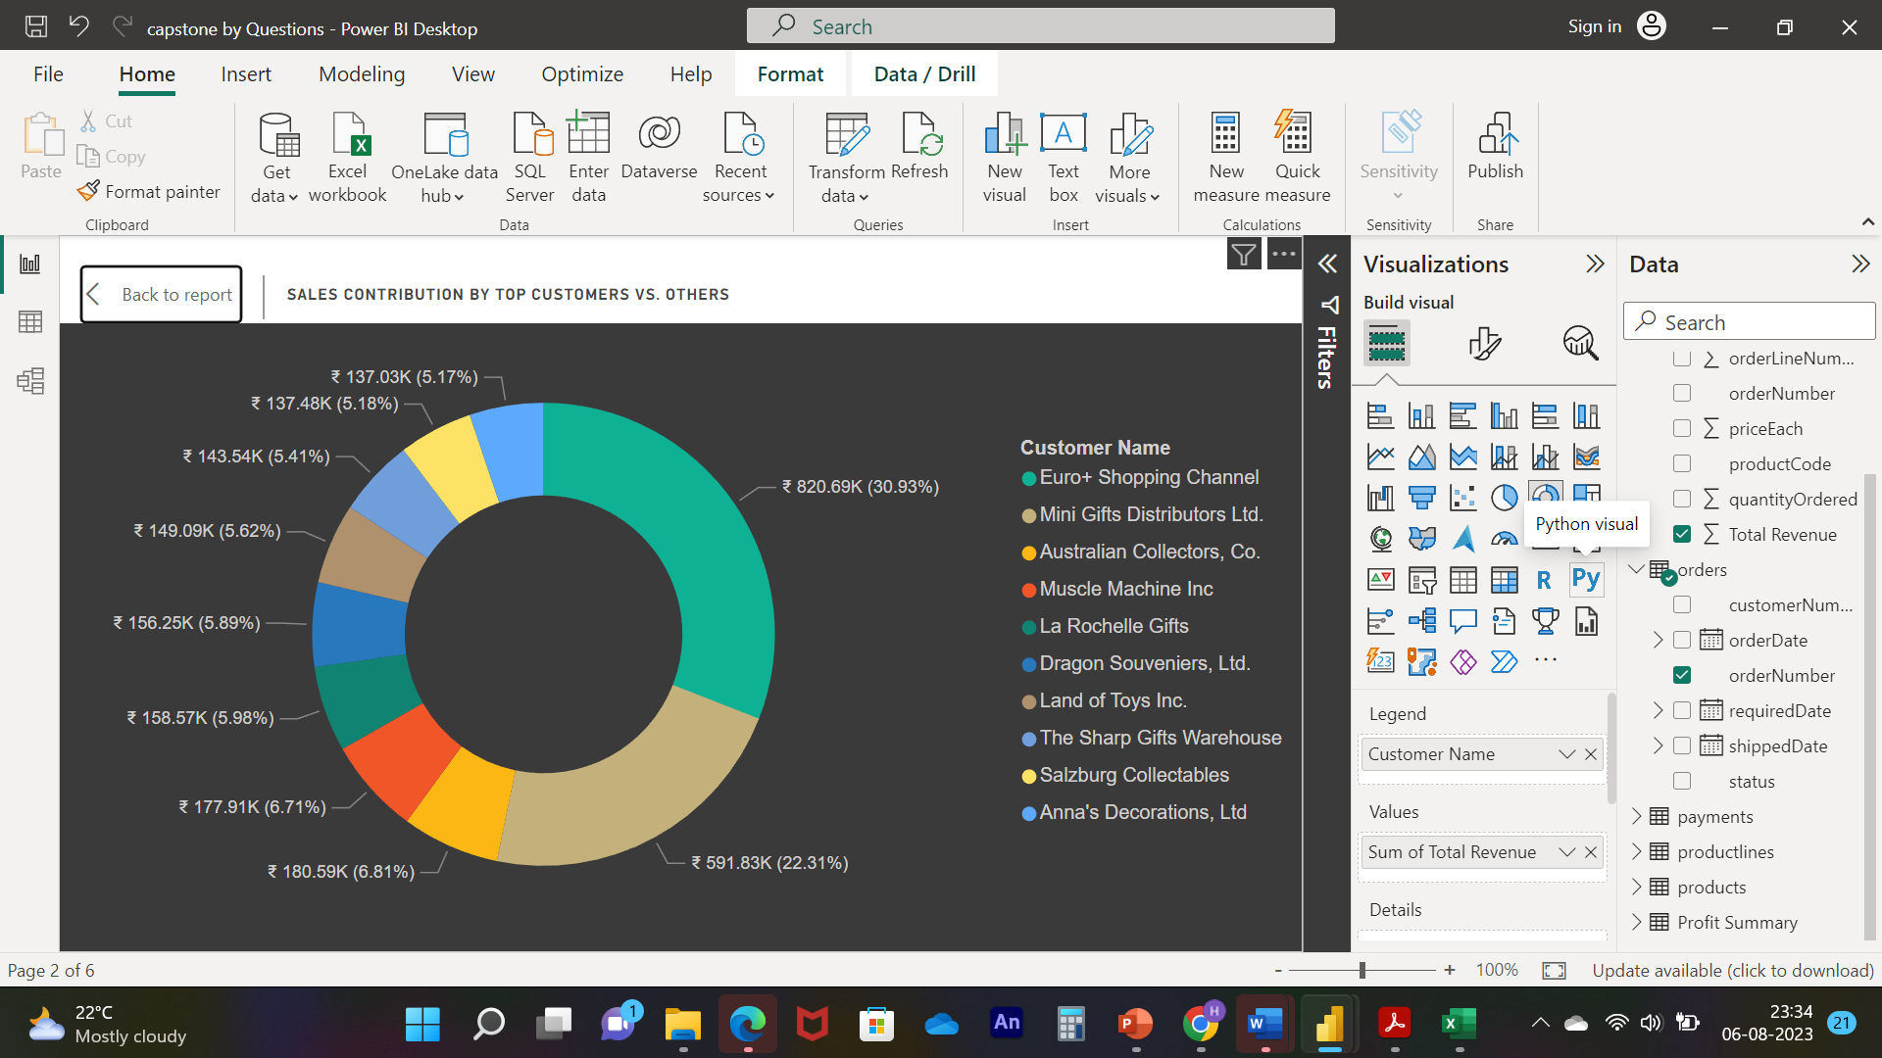
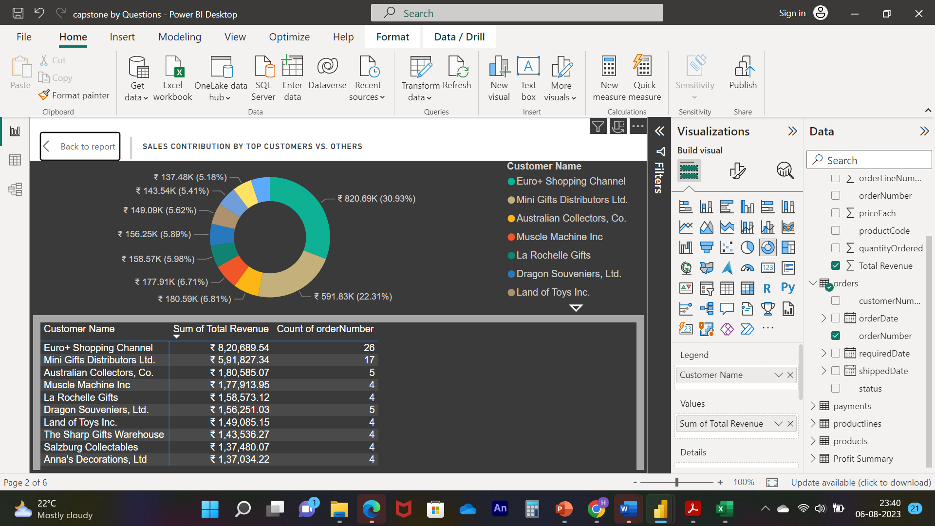
Notes:
Q. NO. 03 :- How does the sales performance of top customers compare to the rest? (Visual: Sales contribution by top customers vs. others)
Solution :- As we can see in visuals the Top 10 Customers Sales Revenue in which we can clearly see the top two customers which is” Euro shopping
channel” and “Mini Gift Distributors ltd” both has more than 50% share of in term of total revenue as well as orders
﻿﻿Euro Shopping Channel accounted for 30.93% of Total Revenue.﻿﻿ ﻿﻿ ﻿

Slide 10
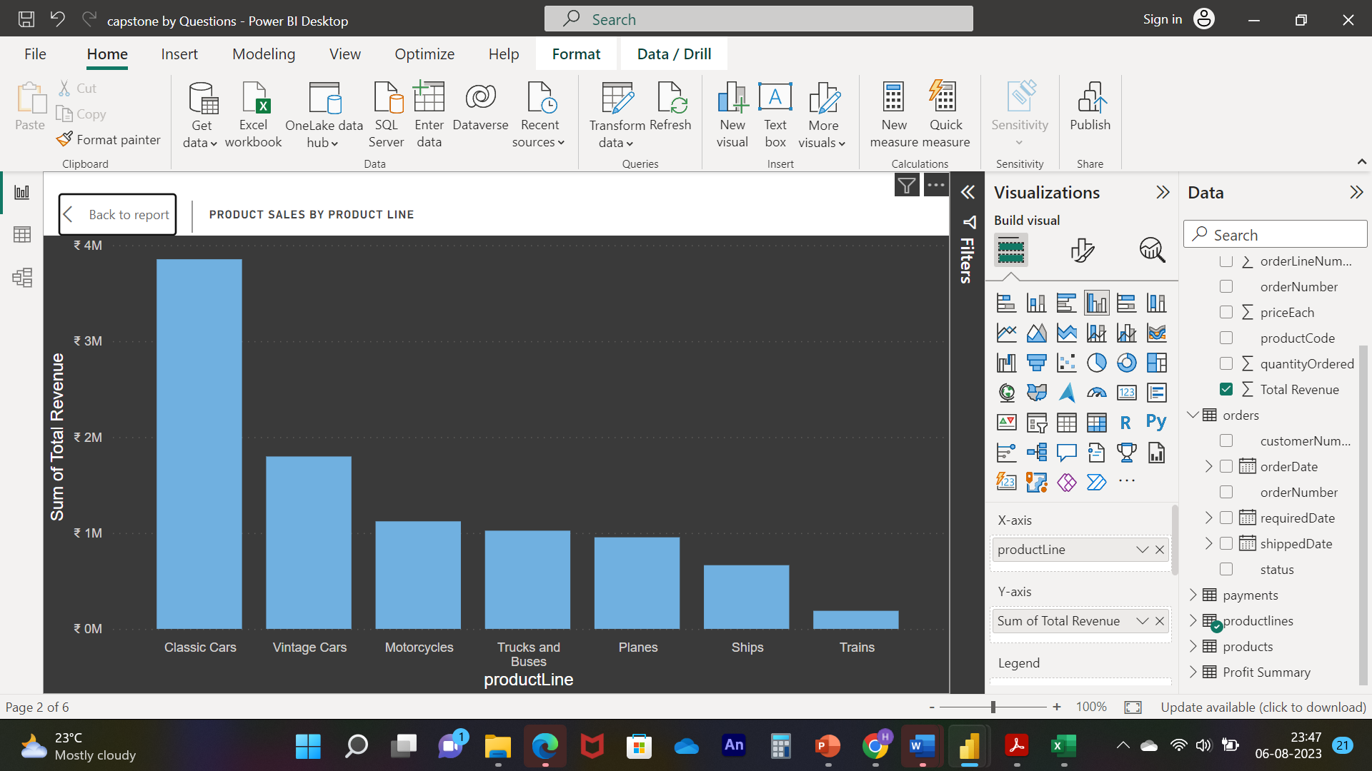
Notes:
Q. NO. 04 :- What is the distribution of product sales across different product lines? (Visual: Product sales by product line)
Solution :- As we can see in visuals the “Classic Cars”and “Vintage cars” has high impact on our sale they can easily engulf others products
So for our future growth we need to focus on our other Category , if they will not perform well then we need to replace some of them with related
other segments or parts
At ₹ 38,53,922.49, Classic Cars had the highest Revenue and was 1,944.16% higher than Trains, which had the lowest
Revenue at ₹ 1,88,532.92.﻿﻿ ﻿﻿Classic Cars accounted for 40.13% of Total Revenue.﻿﻿ ﻿﻿ ﻿﻿Across all 7 product Line, Total Revenue ranged from
₹ 1,88,532.92 to ₹ 38,53,922.49.﻿﻿ ﻿﻿ ﻿

Slide 11
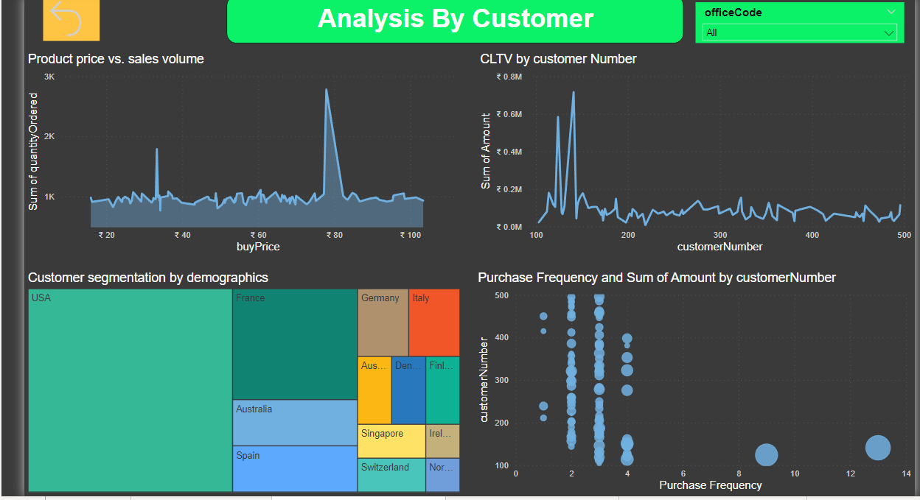
easily
Notes:
Analyzing customers involves understanding their behaviors, preferences, and needs. This can be done through techniques like customer segmentation, where you group customers based on shared characteristics. By studying customer buying patterns and feedback, you can tailor your products and services to better suit their demands. This analysis helps in creating personalized marketing campaigns, enhancing customer satisfaction, and driving loyalty,
From above slide we can get some insight that will really beneficial for our future scope as well as expansions of our businesses,
By CLTV we can understand those customers which are with us from long time , and we gain there trust as well , also we get to know most repeated customer, and we need to focused on gaining more repeated Customers because currently we are not getting attention from repeated Customers ,
INSIGHT : From Above Analysis we get some insight that is
1)we need to focused on gaining attention of repeated customers
2) Need to Expand our Business Beyond the USA
3) Need to work on Different Attractive Pricing Stratergy

Slide 12
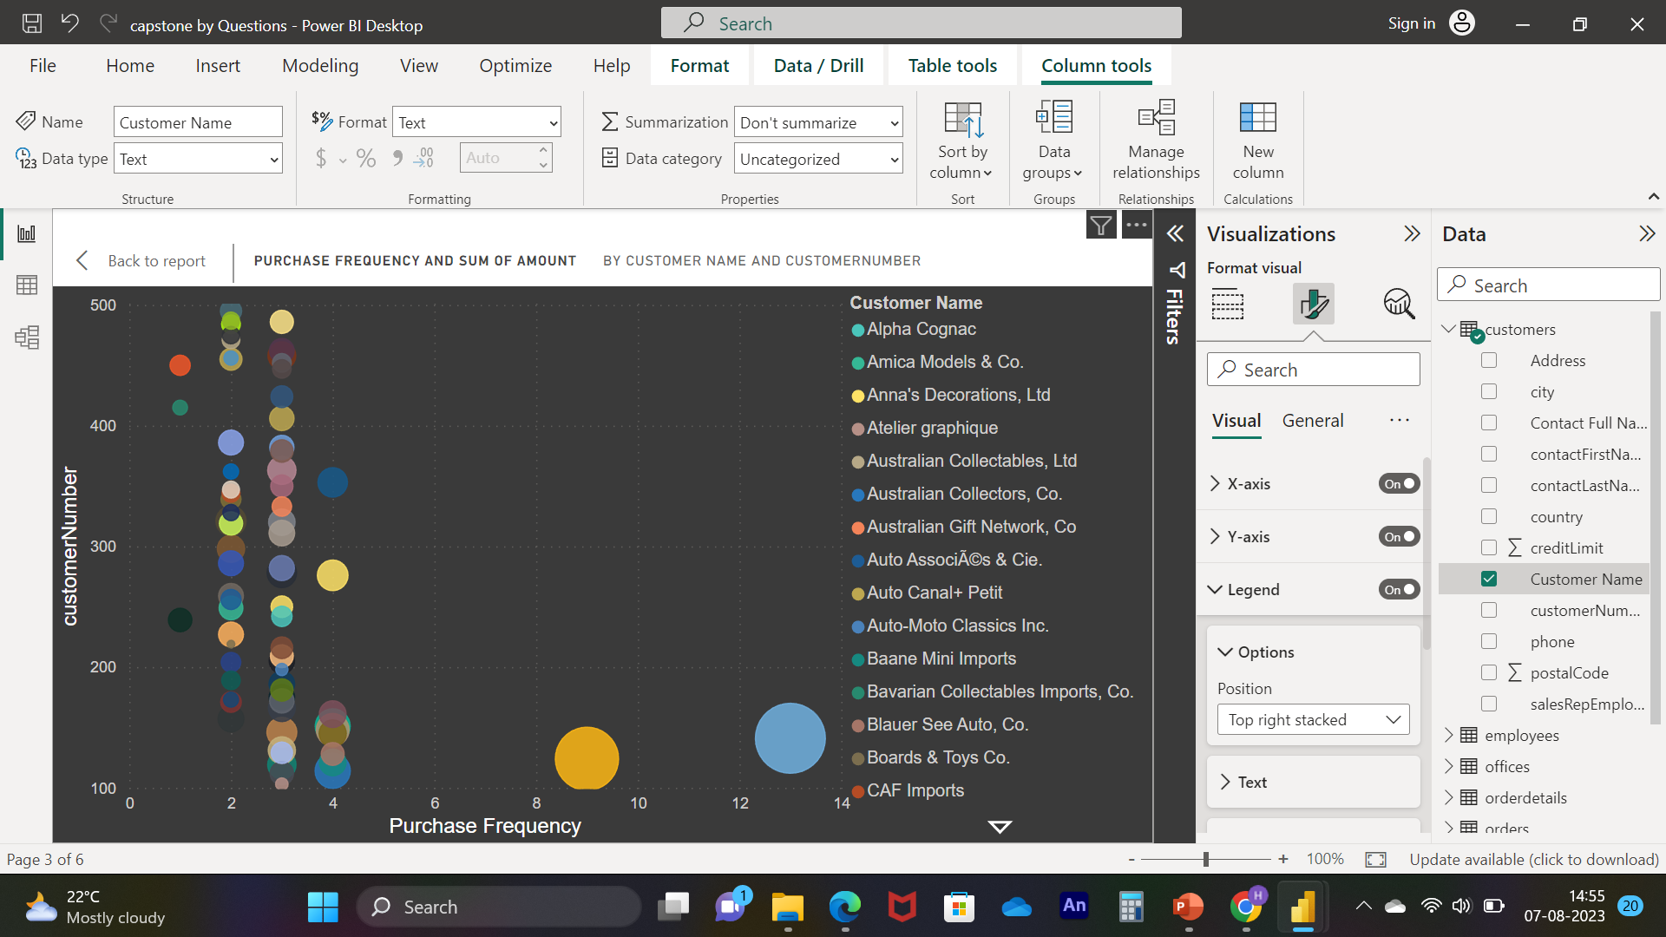
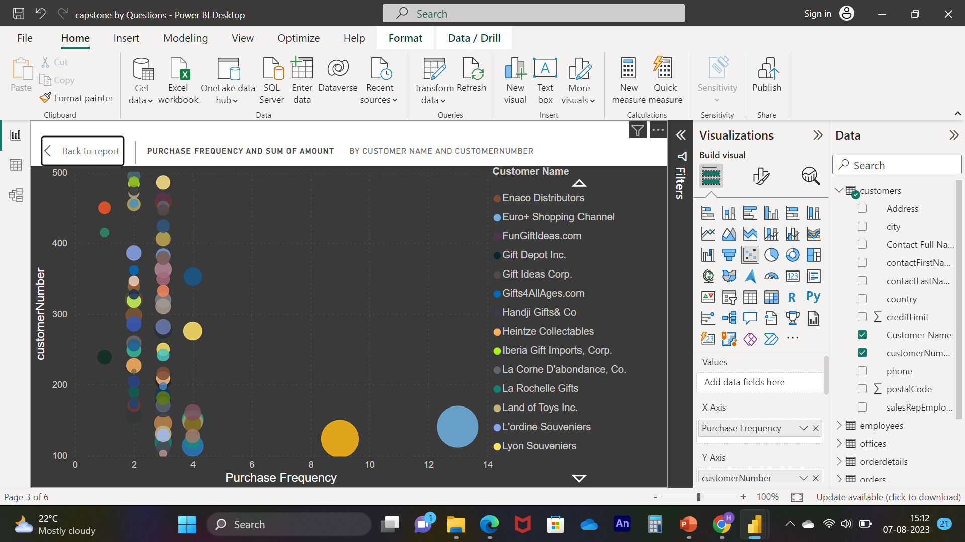
Notes:
Q. NO. 05 :- What is the correlation between customer number and purchase frequency? (Visual: Customer Numbers vs. purchase frequency)
Solution :- As we can see in visuals the ﻿Euro Shopping Channel had the highest Purchase Frequency (13) and Sum of Amount (₹ 7,15,738.98). The customer Number with the highest Purchase Frequency and Sum of Amount was 141.﻿﻿ ﻿﻿ ﻿﻿Most Customer Name were below 3 in Purchase Frequency and below ₹ 95,341.53 in Sum of Amount.﻿﻿ ﻿﻿ ﻿

Slide 13
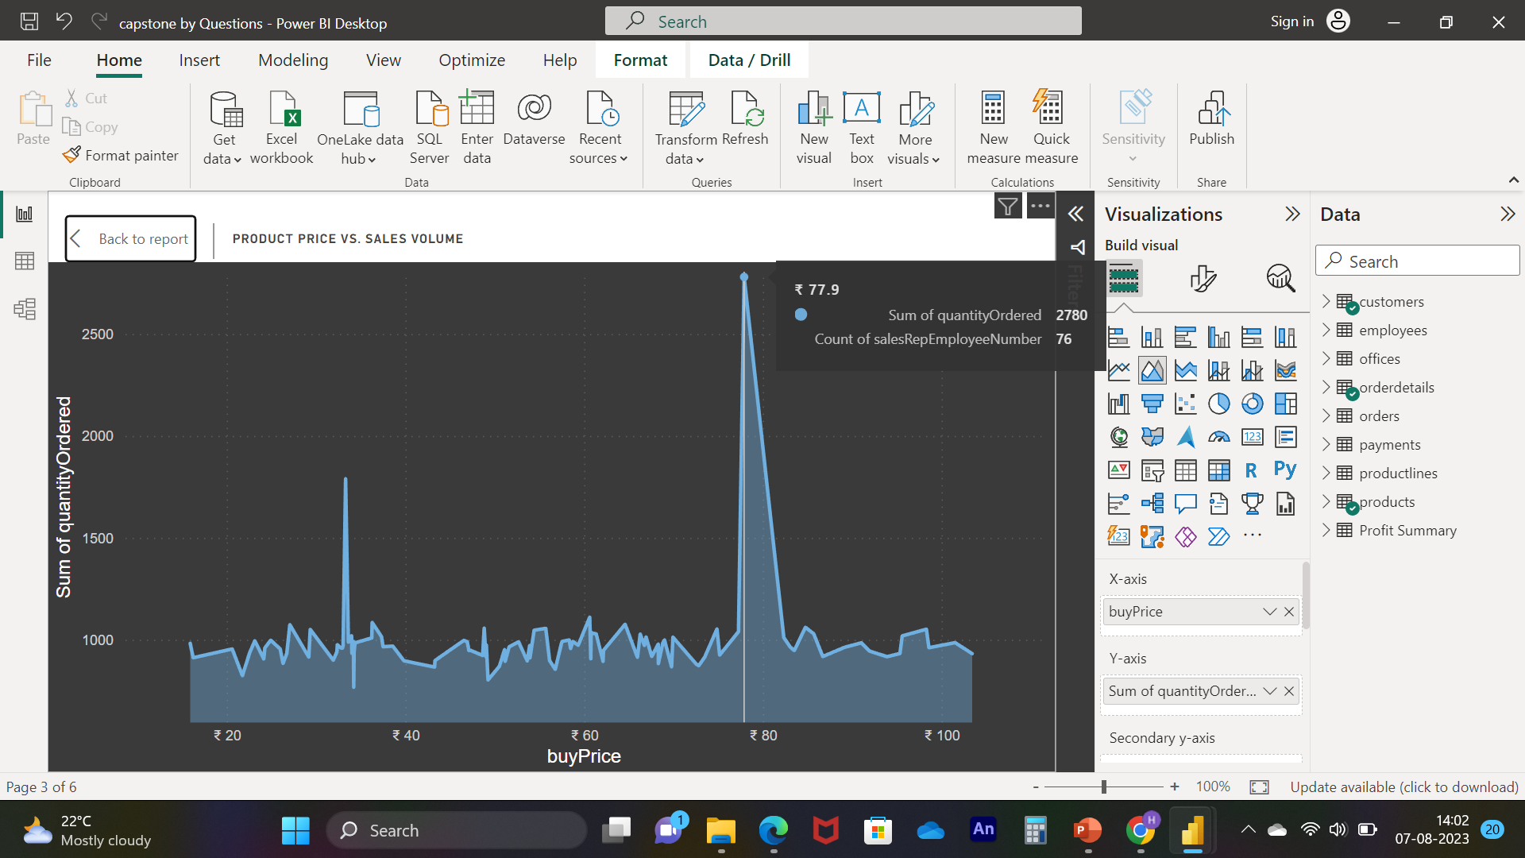
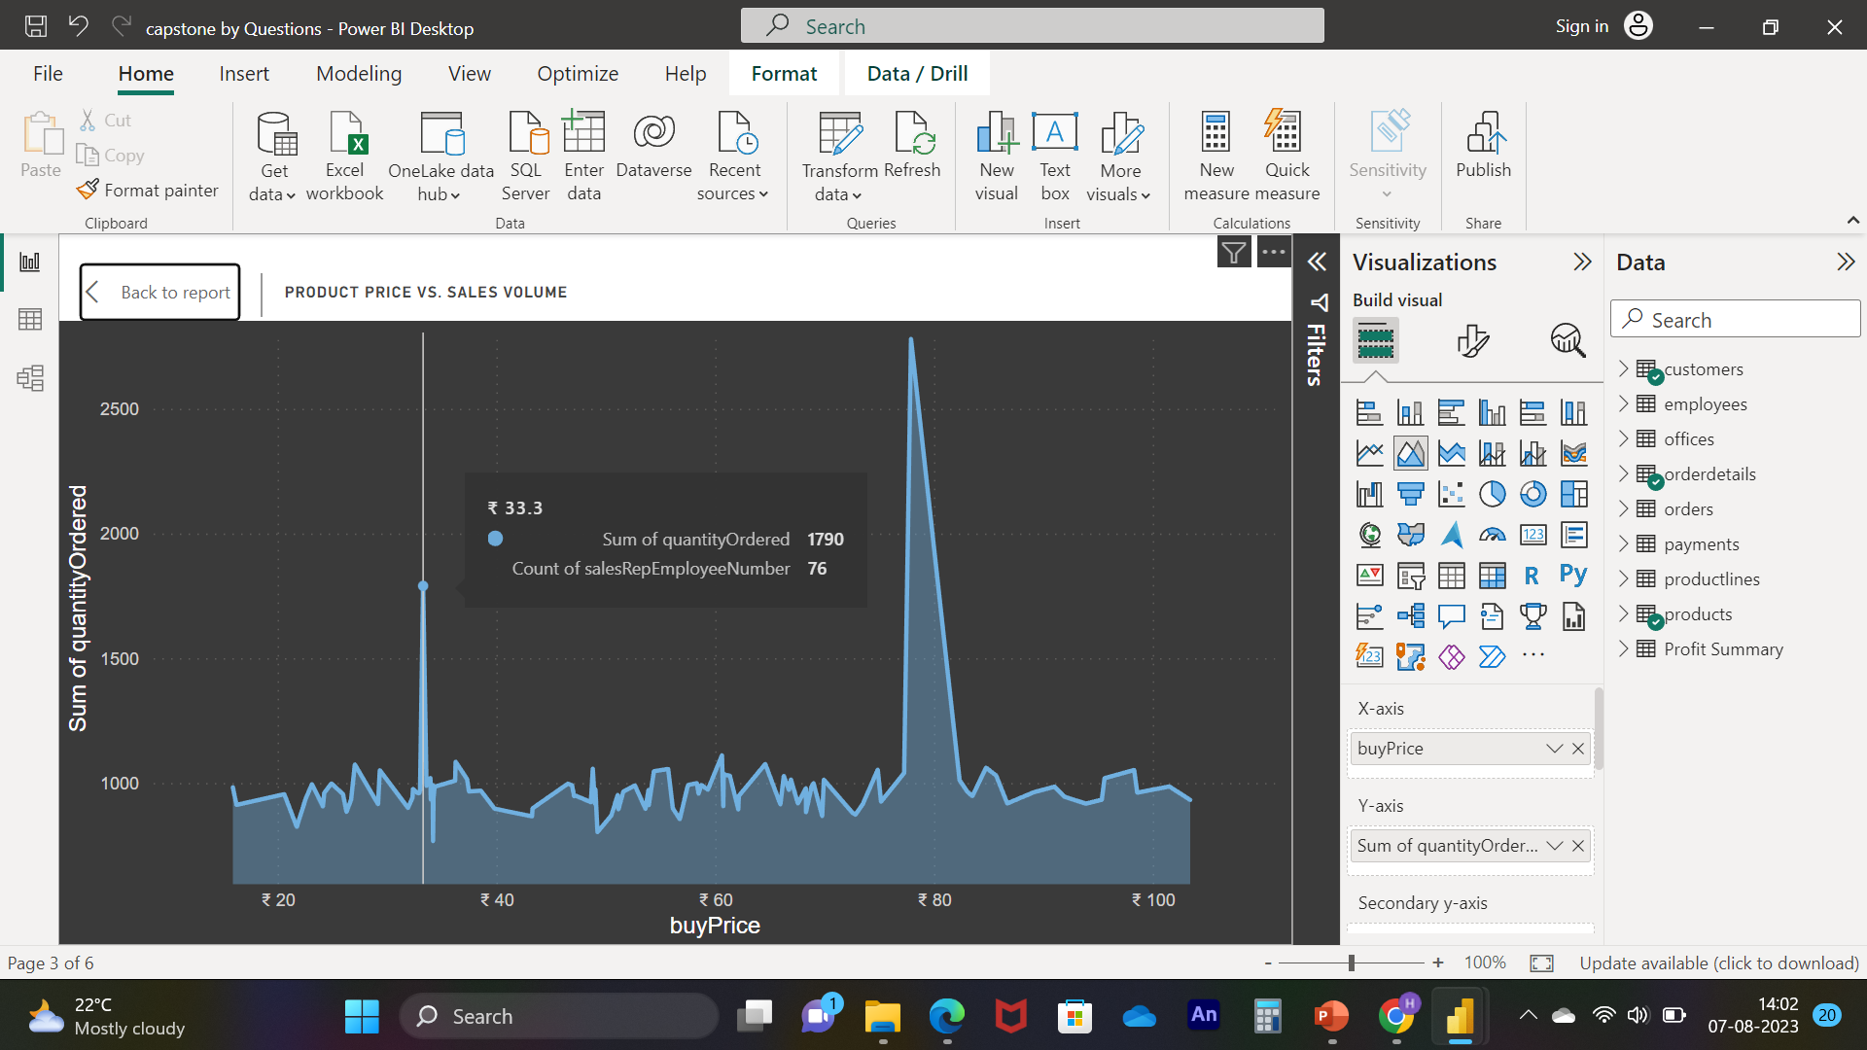
Notes:
Q. NO. 06 :-How does product pricing impact sales volume? (Visual: Product price vs. sales volume)
Solution :- As we can see in visuals there is two product pricing has more impact as compare to others ﻿At 2780, ₹ 77.9 had the highest Order quantity and was 262.45% higher than ₹ 34.21, which had the lowest Orders quantity 767.﻿﻿ ﻿﻿
﻿﻿₹ 77.9 had the highest Order quantity at 2780, followed by ₹ 33.3 and ₹ 60.62. ₹ 34.21 had the lowest orders quantity at 767.﻿﻿ ﻿﻿
﻿﻿₹ 77.9 accounted for 2.63% of all orders quantity.﻿﻿ ﻿﻿ ﻿﻿Across all 107 product Price, order quantity ranged from 767 to 2780.﻿﻿ ﻿﻿ ﻿

Slide 14
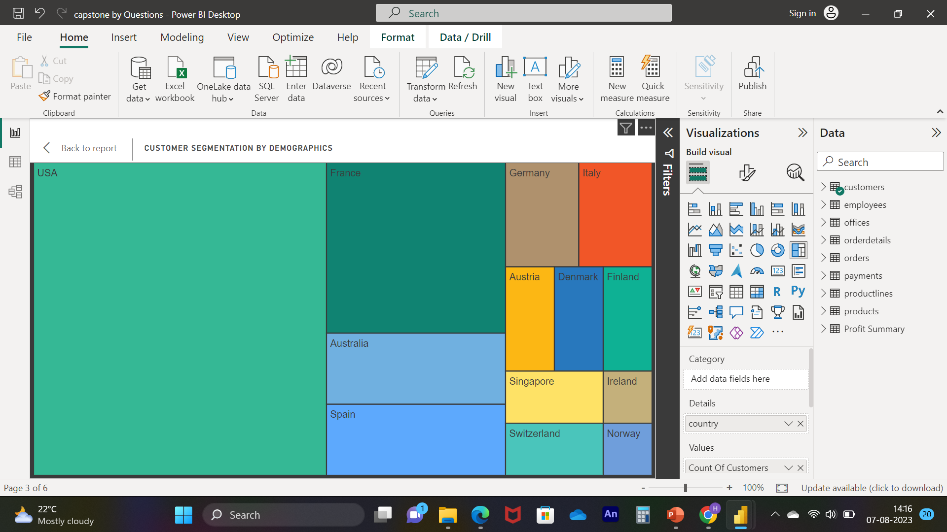
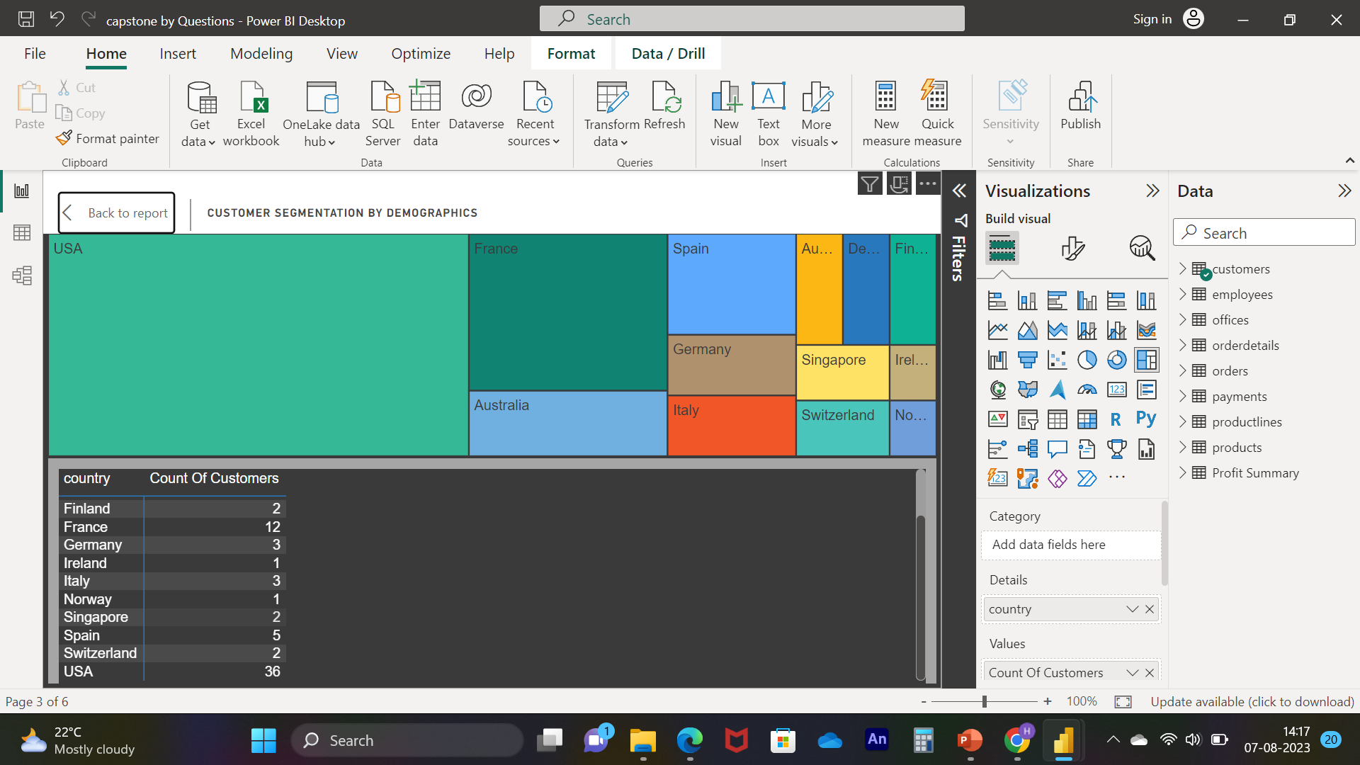
Notes:
Q. NO. 07 :- What is the distribution of customers across different demographic segments? (Visual: Customer segmentation by demographics)
Solution :- As we can see in visual we get more number of customers from USA which is 36 and followed by France
which is 12 , we also need to focus on to get more numbers of customers from other regions as well
because as we can see in the market every year there is lot of competition are coming so for maintaining
balance as well as smooth business
Count Of Customers was highest for USA at 36, followed by France and Australia.﻿﻿ ﻿﻿ ﻿﻿USA accounted
for 47.37% of Count Of Customers.﻿﻿ ﻿﻿ ﻿﻿Across all 13 country, Count Of Customers ranged from 1 to 36.﻿﻿
﻿﻿ ﻿It's important to recognize the broader picture – across all 13 countries in consideration, the count of customers varied from 1 to 36. This variance underscores the need for a more even distribution of customers to ensure the business remains competitive and resilient.

Slide 15
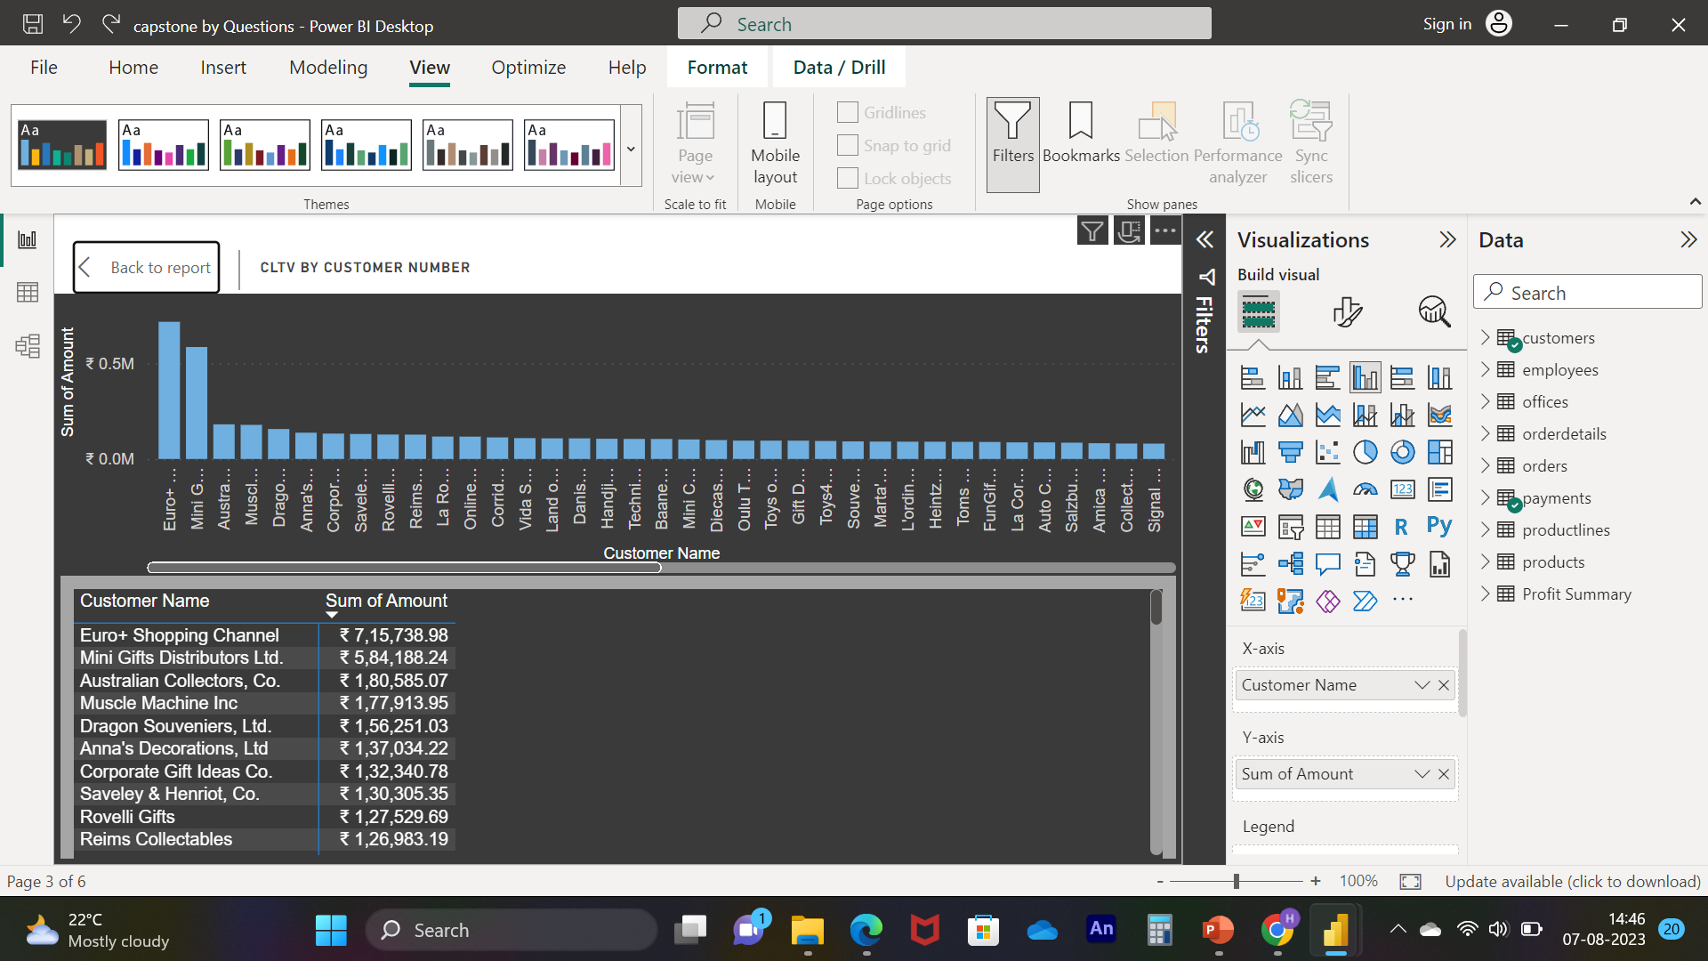
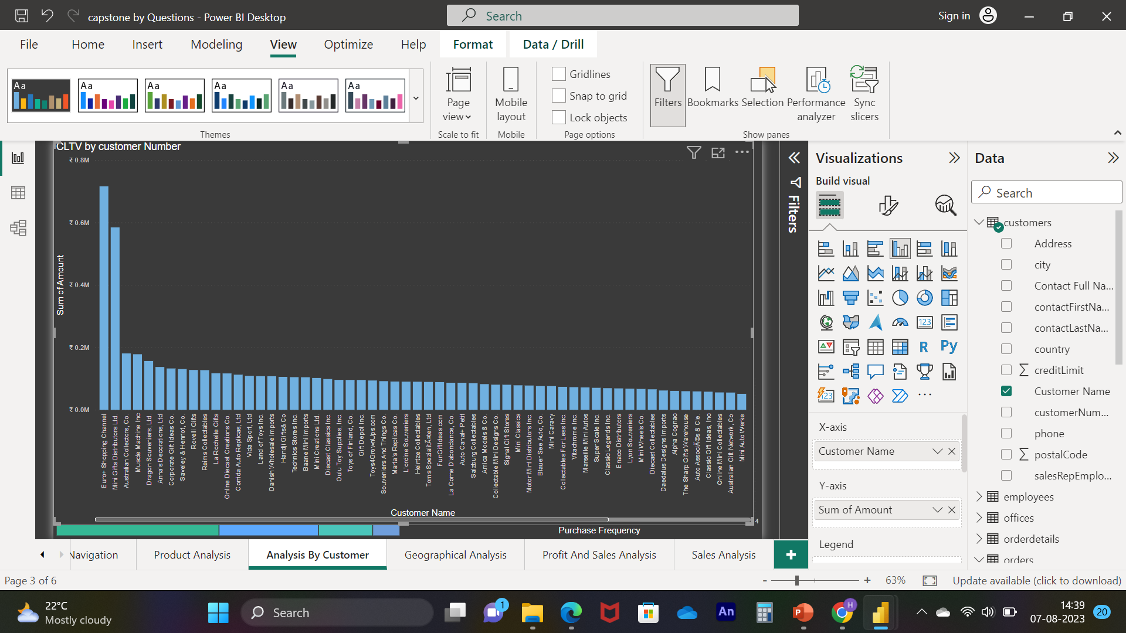
Notes:
Q. NO. 08 :- How does customer lifetime value vary for different customer acquisition channels? (Visual: CLTV by acquisition channel)
Solution :- As we can see in visuals the as well as in table Top CLTV by Customer Names
﻿At ₹ 7,15,738.98, Euro Shopping Channel had the highest Sum of Amount and was 8,938.71% higher than Boards & Toys Co., which had the lowest Sum of Amount at ₹ 7,918.6.﻿﻿ ﻿﻿ ﻿﻿Euro Shopping Channel accounted for 10.14% of Sum of Amount.﻿﻿ ﻿﻿ ﻿﻿Across all 74 Customer Name,
Sum of Amount ranged from ₹ 7,918.6 to ₹ 7,15,738.98.﻿﻿ ﻿﻿ ﻿

Slide 16
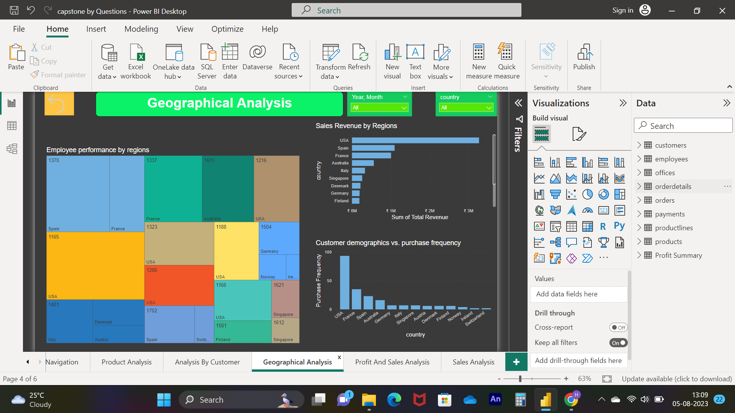
Notes:
Geographical analysis examines your sales, customer base, and other business metrics across different regions or locations. This analysis helps identify which regions are performing well, which ones might need more attention, and if there are any geographic trends influencing your business. It can aid in optimizing distribution strategies, targeting specific markets, and adapting products to local preferences.
Insight 1) we need to find out why other demographical Customer not purchasing our product
is they have different customers or they are in different business so we need to find our alternative
product to there business
2) need to take survey of our employee in which we need to ask them what motivate you to do more sales
why they are not giving best performance or they are lack of orders,
If they are facing lack of orders then we need to focused on our marketing strategy’s

Slide 17
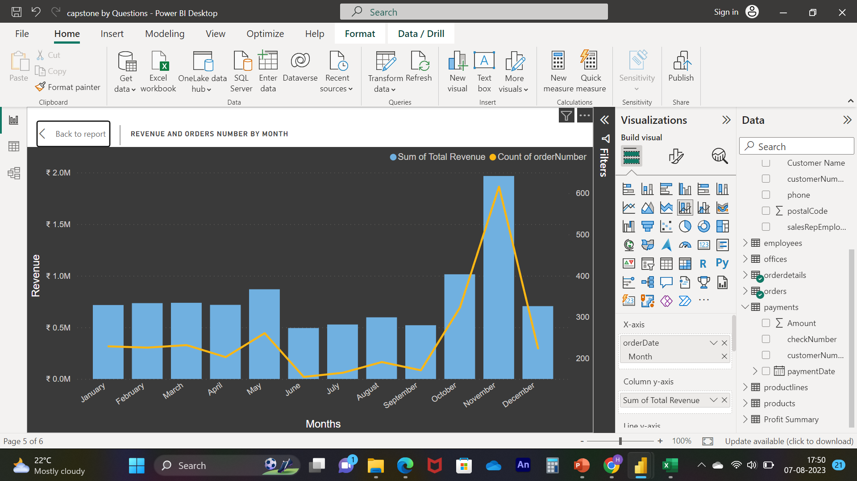
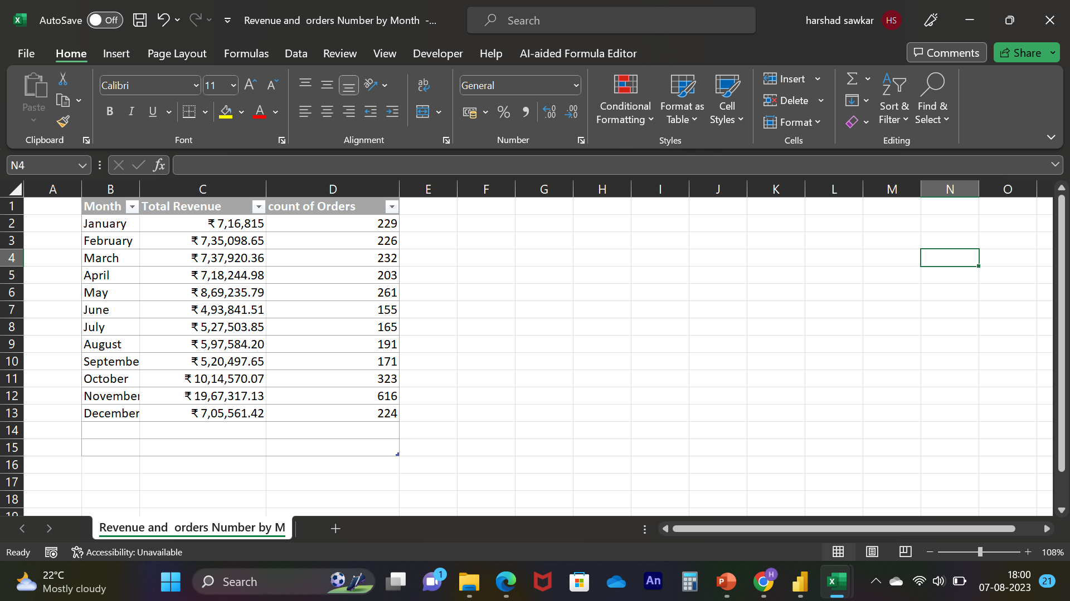
Notes:
Q. NO. 09 :- What is the correlation between customer age and purchase frequency? (Visual: Customer age vs. purchase frequency)
for above statement we don’t have sufficient data to know age so instead of this we consider new problem statement
New Q. what is the relation between Revenue and Orders , are they correlated with each other ?
Solution :- as we can see in visuals ﻿At ₹ 19,67,317.13, November had the highest Revenue and was 298.37% higher than June, which had the lowest Revenue at ₹ 4,93,841.51.﻿﻿ ﻿﻿ ﻿﻿Revenue and total order’s are positively correlated with each other.﻿﻿ ﻿﻿ ﻿﻿November accounted for 20.48% of Total Revenue.﻿﻿ ﻿﻿ ﻿﻿Total Revenue and Count of order’s diverged the most when the Month was November, when Total Revenue were ₹ 19,66,701.13 higher than Count of order’s.﻿﻿ ﻿﻿ ﻿
For the business, it's valuable to delve further into the factors that led to the significant revenue in November, as this insight can inform strategies to optimize revenue in other months as well. Additionally, exploring the correlation between revenue and order counts can help identify patterns and opportunities for maximizing overall profitability.

Slide 18
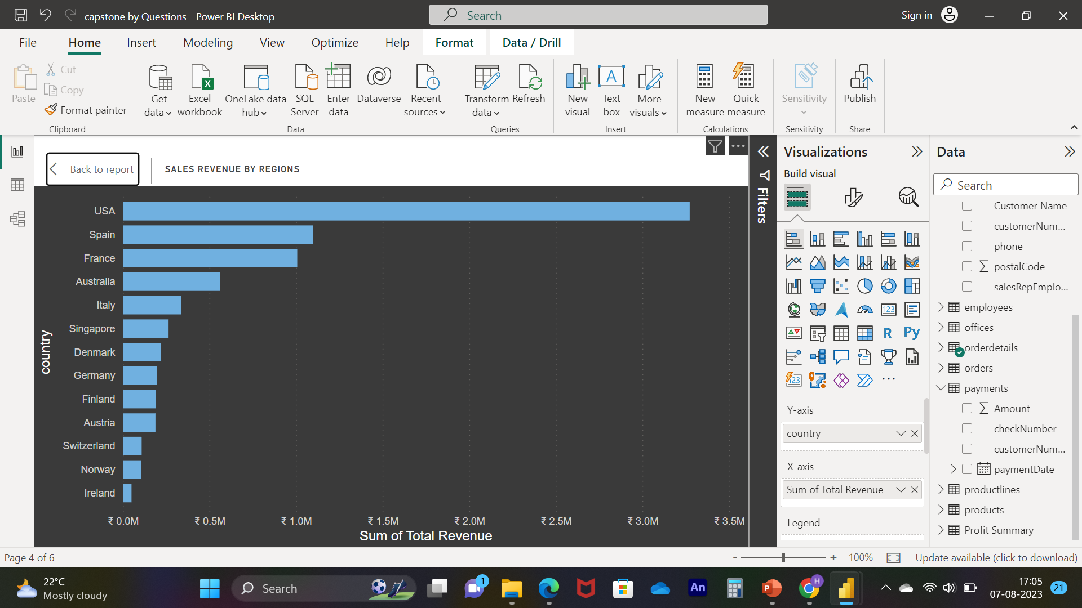
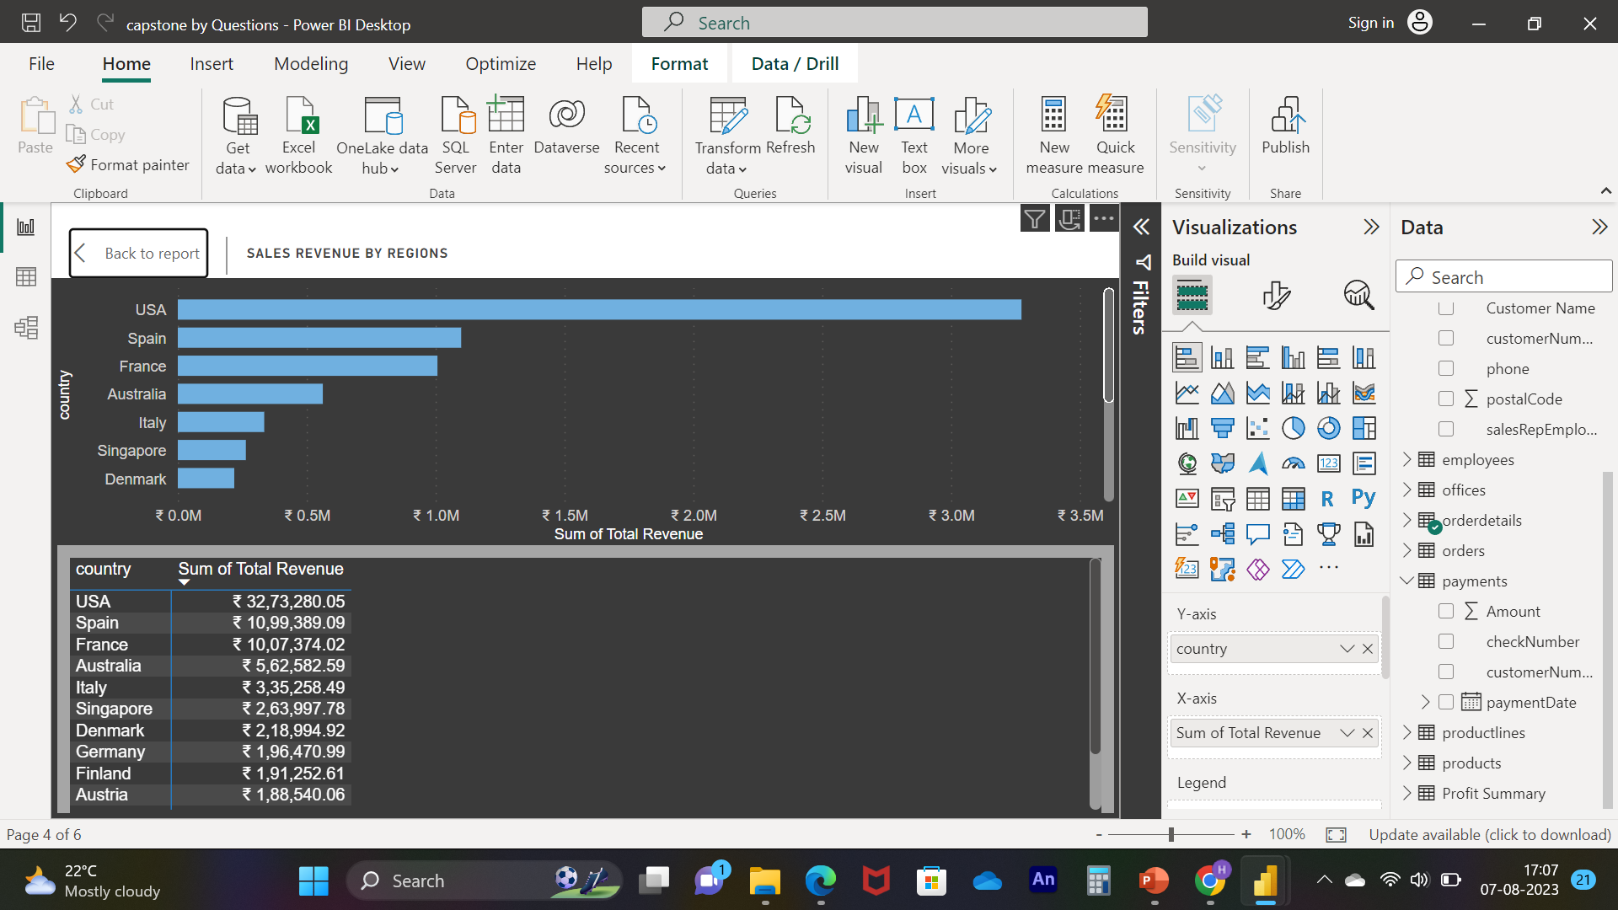
Notes:
Q. NO. 10 :- What are the top regions in terms of sales revenue? (Visual: Sales revenue by region)
Solution :- As we can see in visuals the ﻿At ₹ 32,73,280.05, USA had the highest Total Revenue and was 6,459.91% higher than Ireland, which had the lowest Sum of Total Revenue at ₹ 49,898.27.﻿﻿ ﻿﻿ ﻿﻿USA accounted for 43.07% of Total Revenue.﻿﻿ ﻿﻿ ﻿﻿Across all 13 country, Total Revenue ranged from ₹ 49,898.27 to ₹ 32,73,280.05.﻿﻿ ﻿﻿ ﻿
We can see In the above table that which Top countries are contributing more , in which USA and SPAIN are the top two country among them.

Slide 19
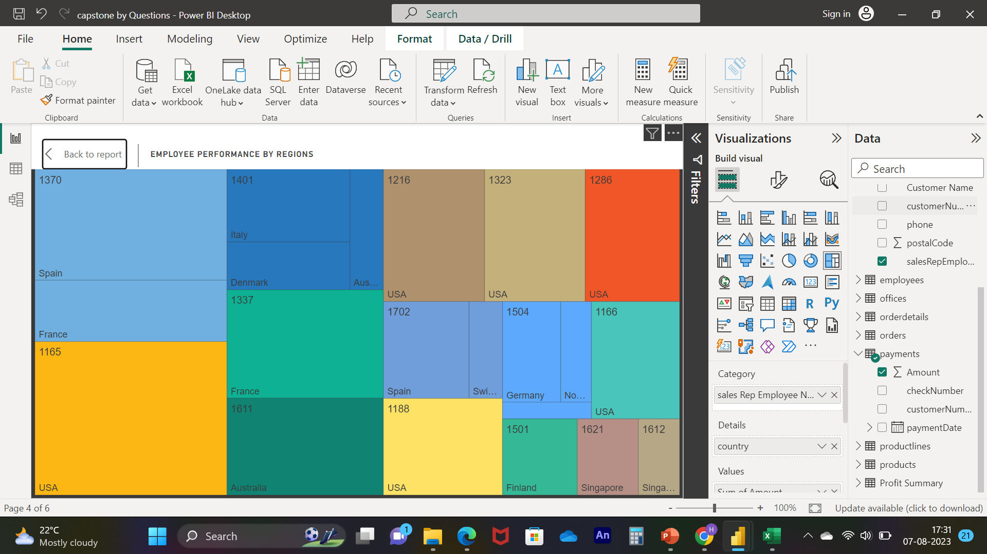
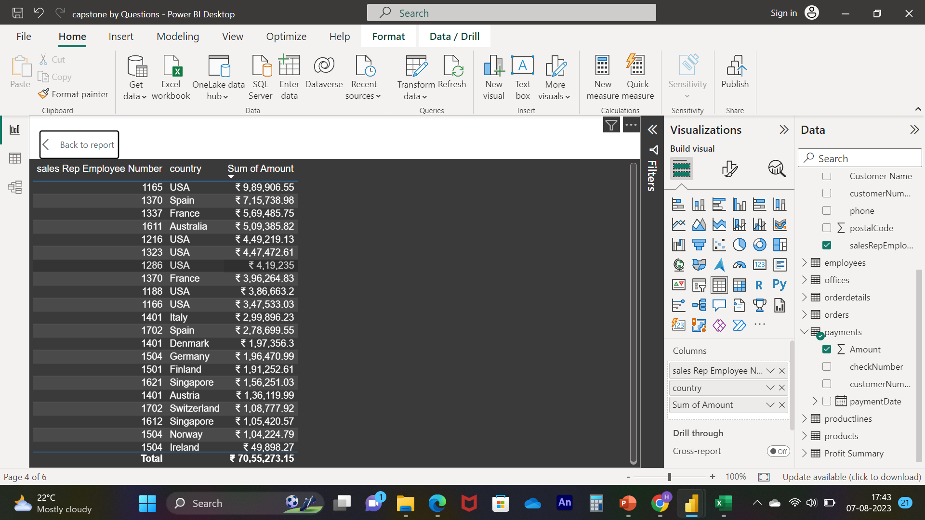
Notes:
Q. NO. 11 :- How does the performance of sales employees vary across different regions? (Visual: Employee performance by region)
Solution :- As we can see in visuals the employee number 1165 in USA country made up 14.03% of Sum of Amount. ﻿USA had the highest total Sum of Amount at ₹ 30,40,029.52, followed by Spain, France, and Singapore.﻿﻿ ﻿﻿ ﻿﻿USA had the highest average Sum of Amount at 5,06,671.59, followed by Spain, France, and Singapore.﻿﻿ ﻿﻿

Slide 20
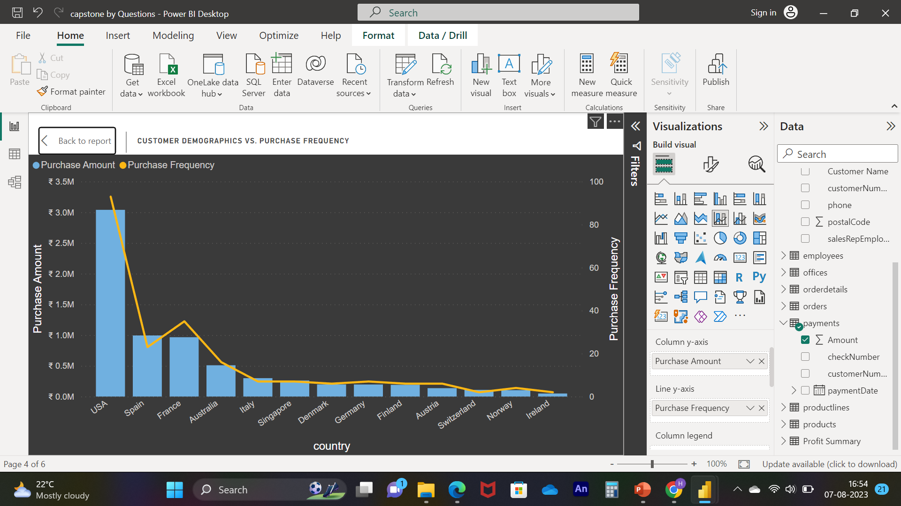
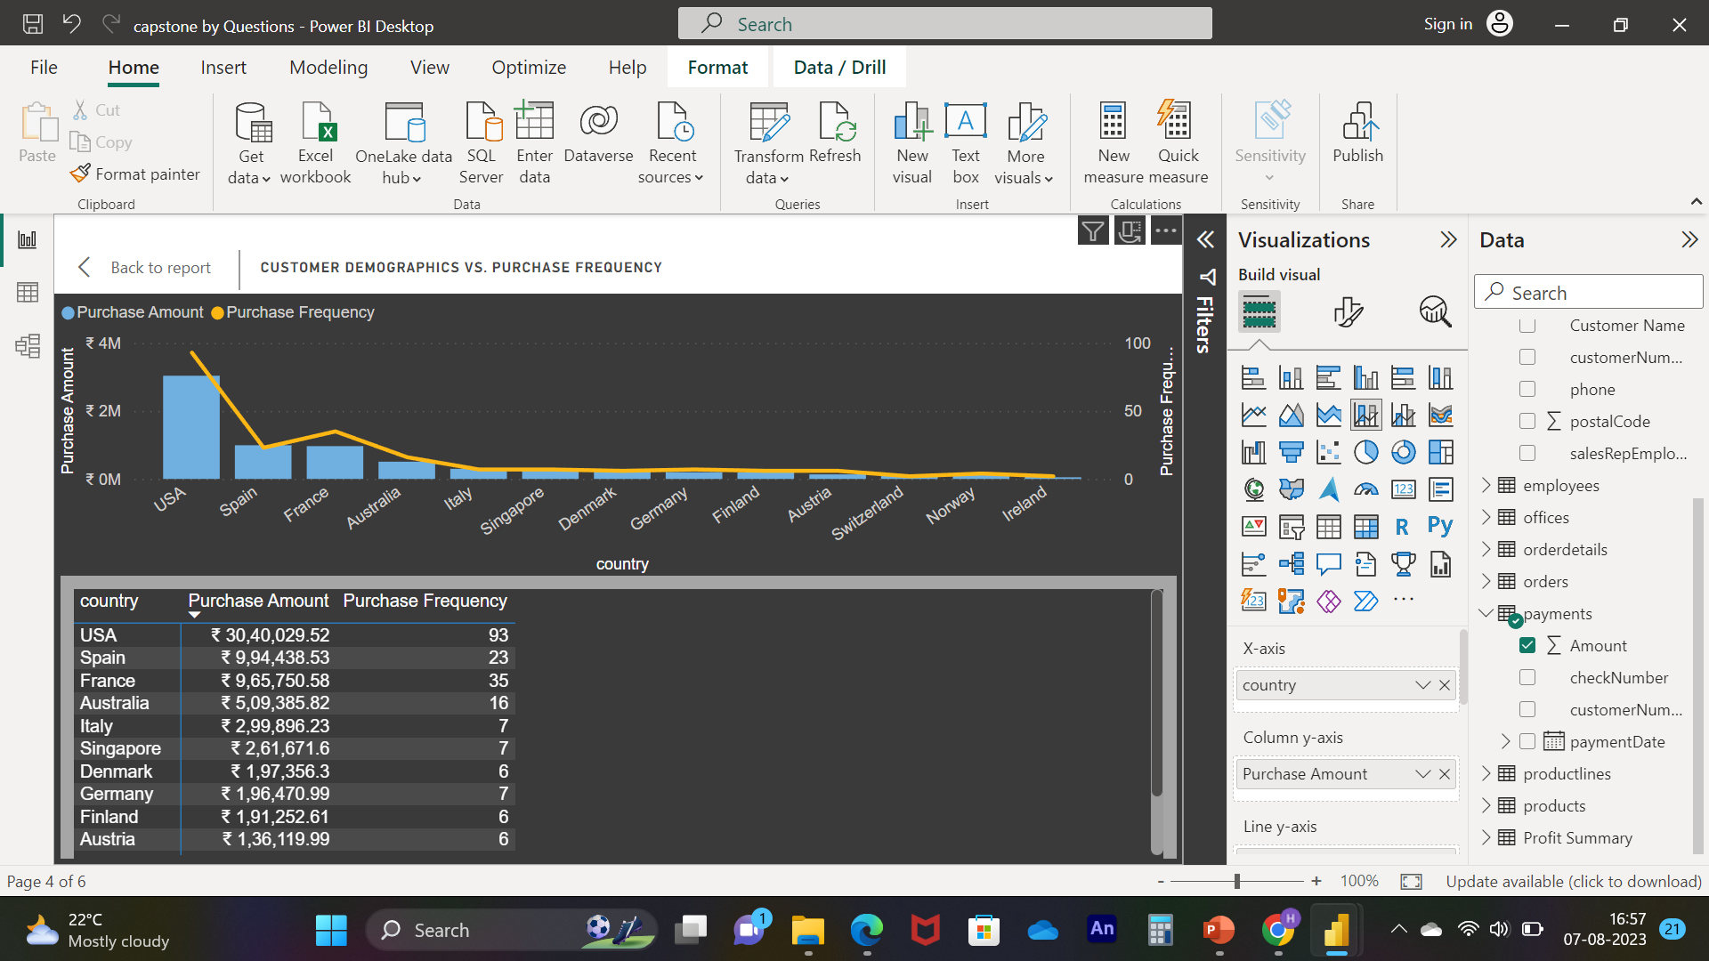
Notes:
Q. NO. 12 :- What is the correlation between customer age and purchase frequency? (Visual: Customer age vs. purchase frequency)
for above statement we don’t have sufficient data to know age so instead of this we consider new problem statement
New Q. what is the repeated frequency of customers by region’s Purchase Amount and Purchase Frequency are correlated with each other ?
Solution :- As we can see in visuals the ﻿At ₹ 30,40,029.52, USA had the highest Purchase Amount and was 5,992.45% higher than Ireland, which had the lowest Purchase Amount at ₹ 49,898.27.﻿﻿ ﻿﻿ ﻿﻿Purchase Amount and total Purchase Frequency are positively correlated with each other.﻿﻿ ﻿﻿ ﻿﻿USA accounted for 43.09% of Purchase Amount.﻿﻿ ﻿﻿ ﻿﻿Purchase Amount and Purchase Frequency diverged the most when the country was USA, when Purchase Amount were ₹ 30,39,936.52 higher than Purchase Frequency.﻿﻿ ﻿﻿ ﻿

Slide 21
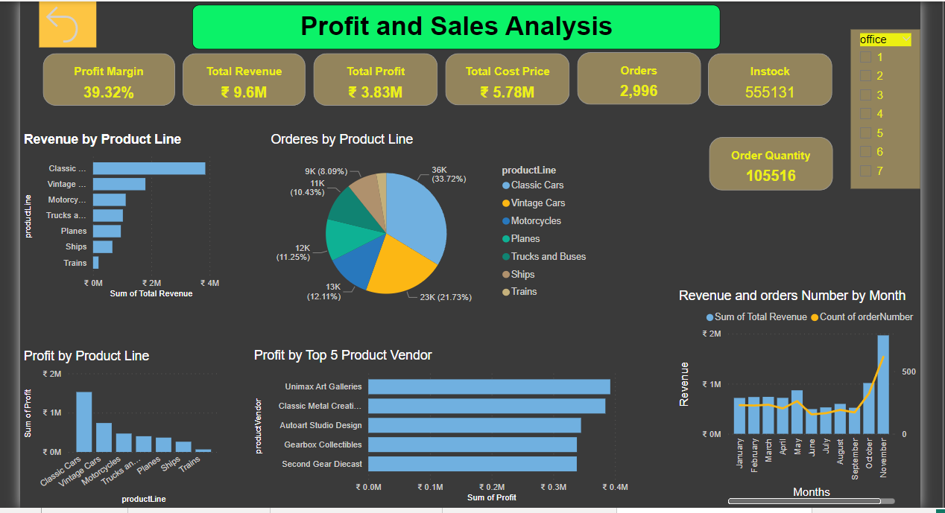
Notes:
Profit and sales analysis involves evaluating your revenue, costs, and overall profitability. By analyzing sales trends and their corresponding profits, you can identify your most profitable products, pricing strategies, and sales channels. This analysis also helps in setting sales targets, assessing the effectiveness of marketing efforts, and making decisions to optimize your profit margins.
Insight 1) we are doing very well in Top product line as well as Top vendor also, if we want to expand our business beyond this
then we need to take same approaches and strategy which are in top product lines , to bring other product line with strong revenues
2) we need to work on inventories as well , because we are spending more on inventories , if we see we have maintain excess inventories that
is 5 time more than order quantity

Slide 22
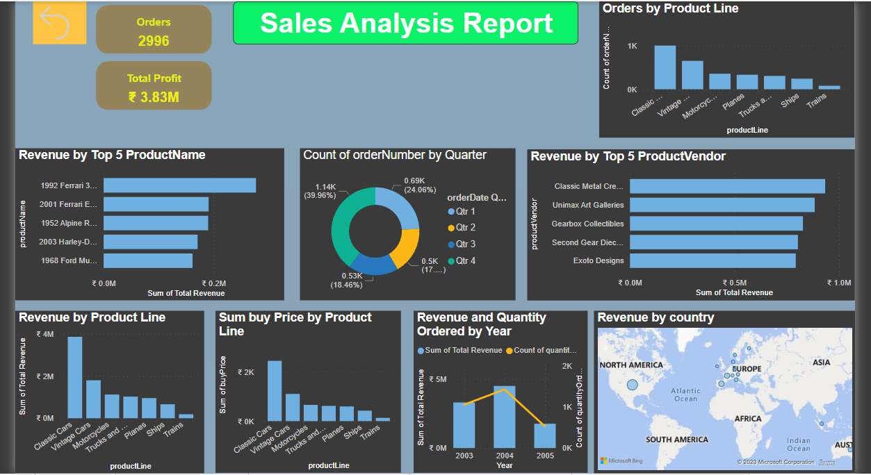
Notes:
Sales Analysis: Sales analysis delves into the details of your sales data to uncover patterns, trends, and insights. This includes analyzing sales by product, region, customer type, time period, and more. By examining this data, you can spot seasonality, identify high-demand periods, and determine which products are driving your revenue. This analysis guides inventory management, sales forecasting, and strategic decision-making.
INSIGHT 1) As we can see we are badly depend on NORTH AMERICA, majority of our all revenue came from north America ,
So this one is risky for our future scopes we need to expand our customers beyond America so If in future we get our competitor in North
America Then that will not affect on our overall businesses
2) as compare to our last two years revenue , current year revenue is going down we need to focuse on what factors that are pulling our
revenue down.

Slide 23



Significance
Valuable insights
Improvement focus
Evaluation of effectiveness
Trend identification
Comprehensive understanding
Notes:
"The Retail Analytics Capstone Project holds substantial significance in the realm of modern business and data-driven decision-making. As the retail industry continues to evolve, the availability of vast amounts of data has presented both opportunities and challenges. This capstone project aims to address these challenges by leveraging advanced data analytics techniques to extract valuable insights from retail data.
The project's significance lies in its potential to revolutionize the way retailers operate. By analyzing historical sales data, customer behavior, inventory levels, and market trends, the project aims to provide actionable insights that can enhance inventory management, optimize pricing strategies, and personalize the customer experience. This not only has the potential to increase profitability for retail businesses but also improve overall customer satisfaction.
Furthermore, the project's outcomes can contribute to the advancement of retail analytics as a field. The methodologies developed and insights gained can serve as valuable contributions to the broader data science community, aiding researchers in refining their understanding of retail dynamics and predictive modeling.
In a broader context, the project aligns with the current trend of data-driven decision-making across industries. As businesses increasingly rely on data to guide their strategies, the successful implementation of this capstone project can serve as a model for other sectors seeking to harness the power of analytics to enhance their operations.
Conclusion : - the Retail Analytics Capstone Project's significance lies in its potential to drive innovation within the retail industry, contribute to the academic and professional understanding of retail analytics, and set an example for data-driven decision-making in contemporary business environments.

Slide 24
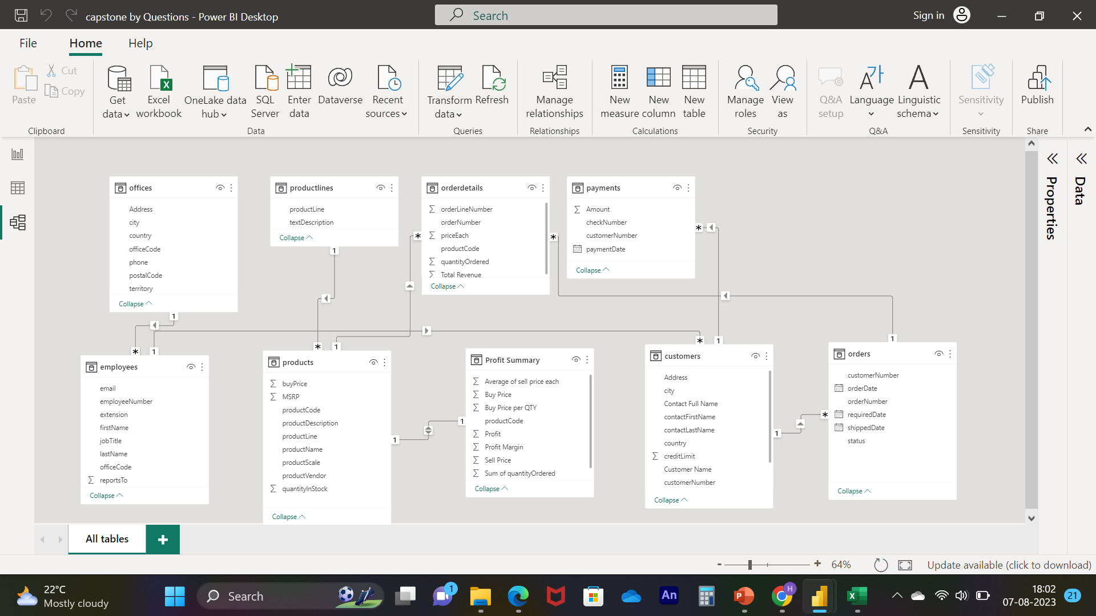
Notes:
Now that we have the problem statement and recognized the significance of the project, let's delve into a thorough understanding of the dataset.
The Entity-Relationship (ER) diagram for the Power BI Dashboard using the above database represents the relationships and interactions between various entities (tables) in the database. Here's an explanation of the ER diagram based on the provided tables:
Table Explanations
Offices Table
This table stores information about the different offices of the retail company, including the office code, city, phone number, address, state, country, postal code, and territory. Each office is uniquely identified by its office code.
Employees Table
The employees table holds data about the company's employees. It includes fields such as employee number (a unique identifier for each employee), last name, first name, extension, email address, office code (identifying the office where the employee works), reportsTo (the employee number of the person to whom the employee reports), and job title.
Customers Table
This table contains information about the retail company's customers. It includes fields like customer number (a unique identifier for each customer), customer name, contact last name, contact first name, phone number, address, city, state, postal code, country, sales representative employee number (identifying the employee responsible for the customer), and credit limit.
Products Table
The products table stores details about the various products sold by the retail company. It includes information such as the product code (a unique identifier for each product), product name, product line (categorization of the product), product scale, product vendor, product description, quantity in stock, buy price, and Manufacturer's Suggested Retail Price (MSRP).
Product Lines Table
This table is used to describe the different product lines available in the company's inventory. It includes fields such as the product line name, text description, HTML description (for web-based content), and an image (stored as a BLOB) to represent the product line visually.
Orders Table
The orders table stores data related to customer orders. It includes information like the order number (a unique identifier for each order), order date, required date, shipped date, order status (using an ENUM for predefined statuses), comments, and customer number (identifying the customer who placed the order).
Order Details Table
This table contains information about the individual items (line items) included in each order. It includes fields such as the order number (linking to the orders table), product code (linking to the products table), quantity ordered, price per item, and order line number.
Payments Table
The payments table stores details about payments made by customers. It includes fields such as the customer number (linking to the customers table), check number, payment date, and the payment amount.
Profit Summary Table
This table act as a helper table , has details about average sell price, Buy Price, Buy Price Per QTY, Product Code , Profit , Profit Margin, Sell Price , Sum of Order Quantity

Slide 25

The data reveals varying revenue patterns across different months. Notably, November stood out with the highest revenue, indicating a potential seasonality or special factors driving higher sales during that time. Further exploration into the reasons behind this spike could guide strategies for maximizing revenue during specific periods.
Notes:
CONCLUSION
Revenue Insights:
The data reveals varying revenue patterns across different months. Notably, November stood out with the highest revenue, indicating a potential seasonality or special factors driving higher sales during that time. Further exploration into the reasons behind this spike could guide strategies for maximizing revenue during specific periods.
Country Contributions:
The data underscores the significance of certain countries, such as the USA and Spain, in generating a substantial portion of the total revenue. These markets appear to be crucial revenue drivers and warrant focused attention in business strategies. Diversifying revenue sources across various regions can mitigate risks associated with overreliance on a single market.
Employee Influence:
An individual employee, denoted as 1165, significantly impacted the overall revenue. Understanding the strategies and practices that contributed to this employee's exceptional performance could provide valuable insights for employee training and recognition programs. Recognizing high-performing individuals can motivate others and enhance overall team performance.
Purchase Behavior Analysis:
The relationship between purchase amounts and purchase frequency is noteworthy. Higher purchase amounts seem to be associated with increased purchase frequency, suggesting that customers who spend more also tend to make more frequent purchases. Analyzing the factors influencing these trends can inform strategies for increasing both average purchase amount and frequency.
Market Dynamics:
The data highlights the need to adapt to changing market dynamics. The intense competition observed annually emphasizes the importance of maintaining a balance between established markets and exploring opportunities in emerging regions. This adaptability will ensure the business remains competitive and resilient in a rapidly evolving retail landscape.
In the realm of retail analytics, these insights provide a foundation for data-driven decision-making. By leveraging the relationships between revenue, customer behavior, and market performance, the business can optimize its strategies for sustained growth, enhanced customer engagement, and improved overall profitability.

